Slide 1
Sustained Earnings and Revenue Growth, Earning Quality, and Earnings Response Coefficients
Author: Aloke Ghosh, Zhaoyang Gu, Prem c.jain
Presented by: Yiqing Feng

Slide 2
Agenda
Background and Hypothesis
Research/Model design
Sample selection
Result statistics and explanation
My own view

Slide 3
Background
Barth et al. (1999): A prior research that shows firms with sustained increases in earnings have higher Earning Response Coefficients(ERC) than other firms
Problem: there are different sources of growth in earning
Sustained Earning Growth
Revenue Increasing Strategy
Cost Reduction Strategy

Slide 4
Hypothesis
Sustained earning growth from a revenue increasing strategy leads to higher earning quality than that from a cost reduction strategy.
The Competitive Strategy Literature
Unlimited Potential vs. Lower Bound
Proactive vs. Reactive
Accounting Perspective: external vs. internal
Intuition
Notes:
- The competitive strategy literature (Porter 1980, 1985): product differentiation is achieved through primary operations and a growing demand for the firms’ products. Firms pursuing product differentiation are able to retain their competitive advantage in the long run and can charge a premium for their products because it is difficult for competing firms to emulate their strategy. On the other hand, it is relatively easy for competitors to emulate the strategy of ‘‘cost-leaders’’ by cutting costs in a similar manner (such as pension plans or healthcare costs).
- Proactive vs reactive: Troubled firms often react to financial distress by utilizing cost cutting as a short-term remedy rather than a long-run solution. One concern with cost cutting programs is that firms are likely to lose the ‘‘muscle’’ while cutting the ‘‘fat,’’ thus hurting the profitability in the long run.3
- External: inventory stuffing, bill and hold, early buy-back
Internal: bad debt, restructuring charges

Slide 5
Hypothesis Summary
Firms that report sustained increases in earnings along with sustained increases in revenues:
Earnings are of higher quality
ERCs are larger than those firms with sustained increases in earnings but not in revenues

Slide 6
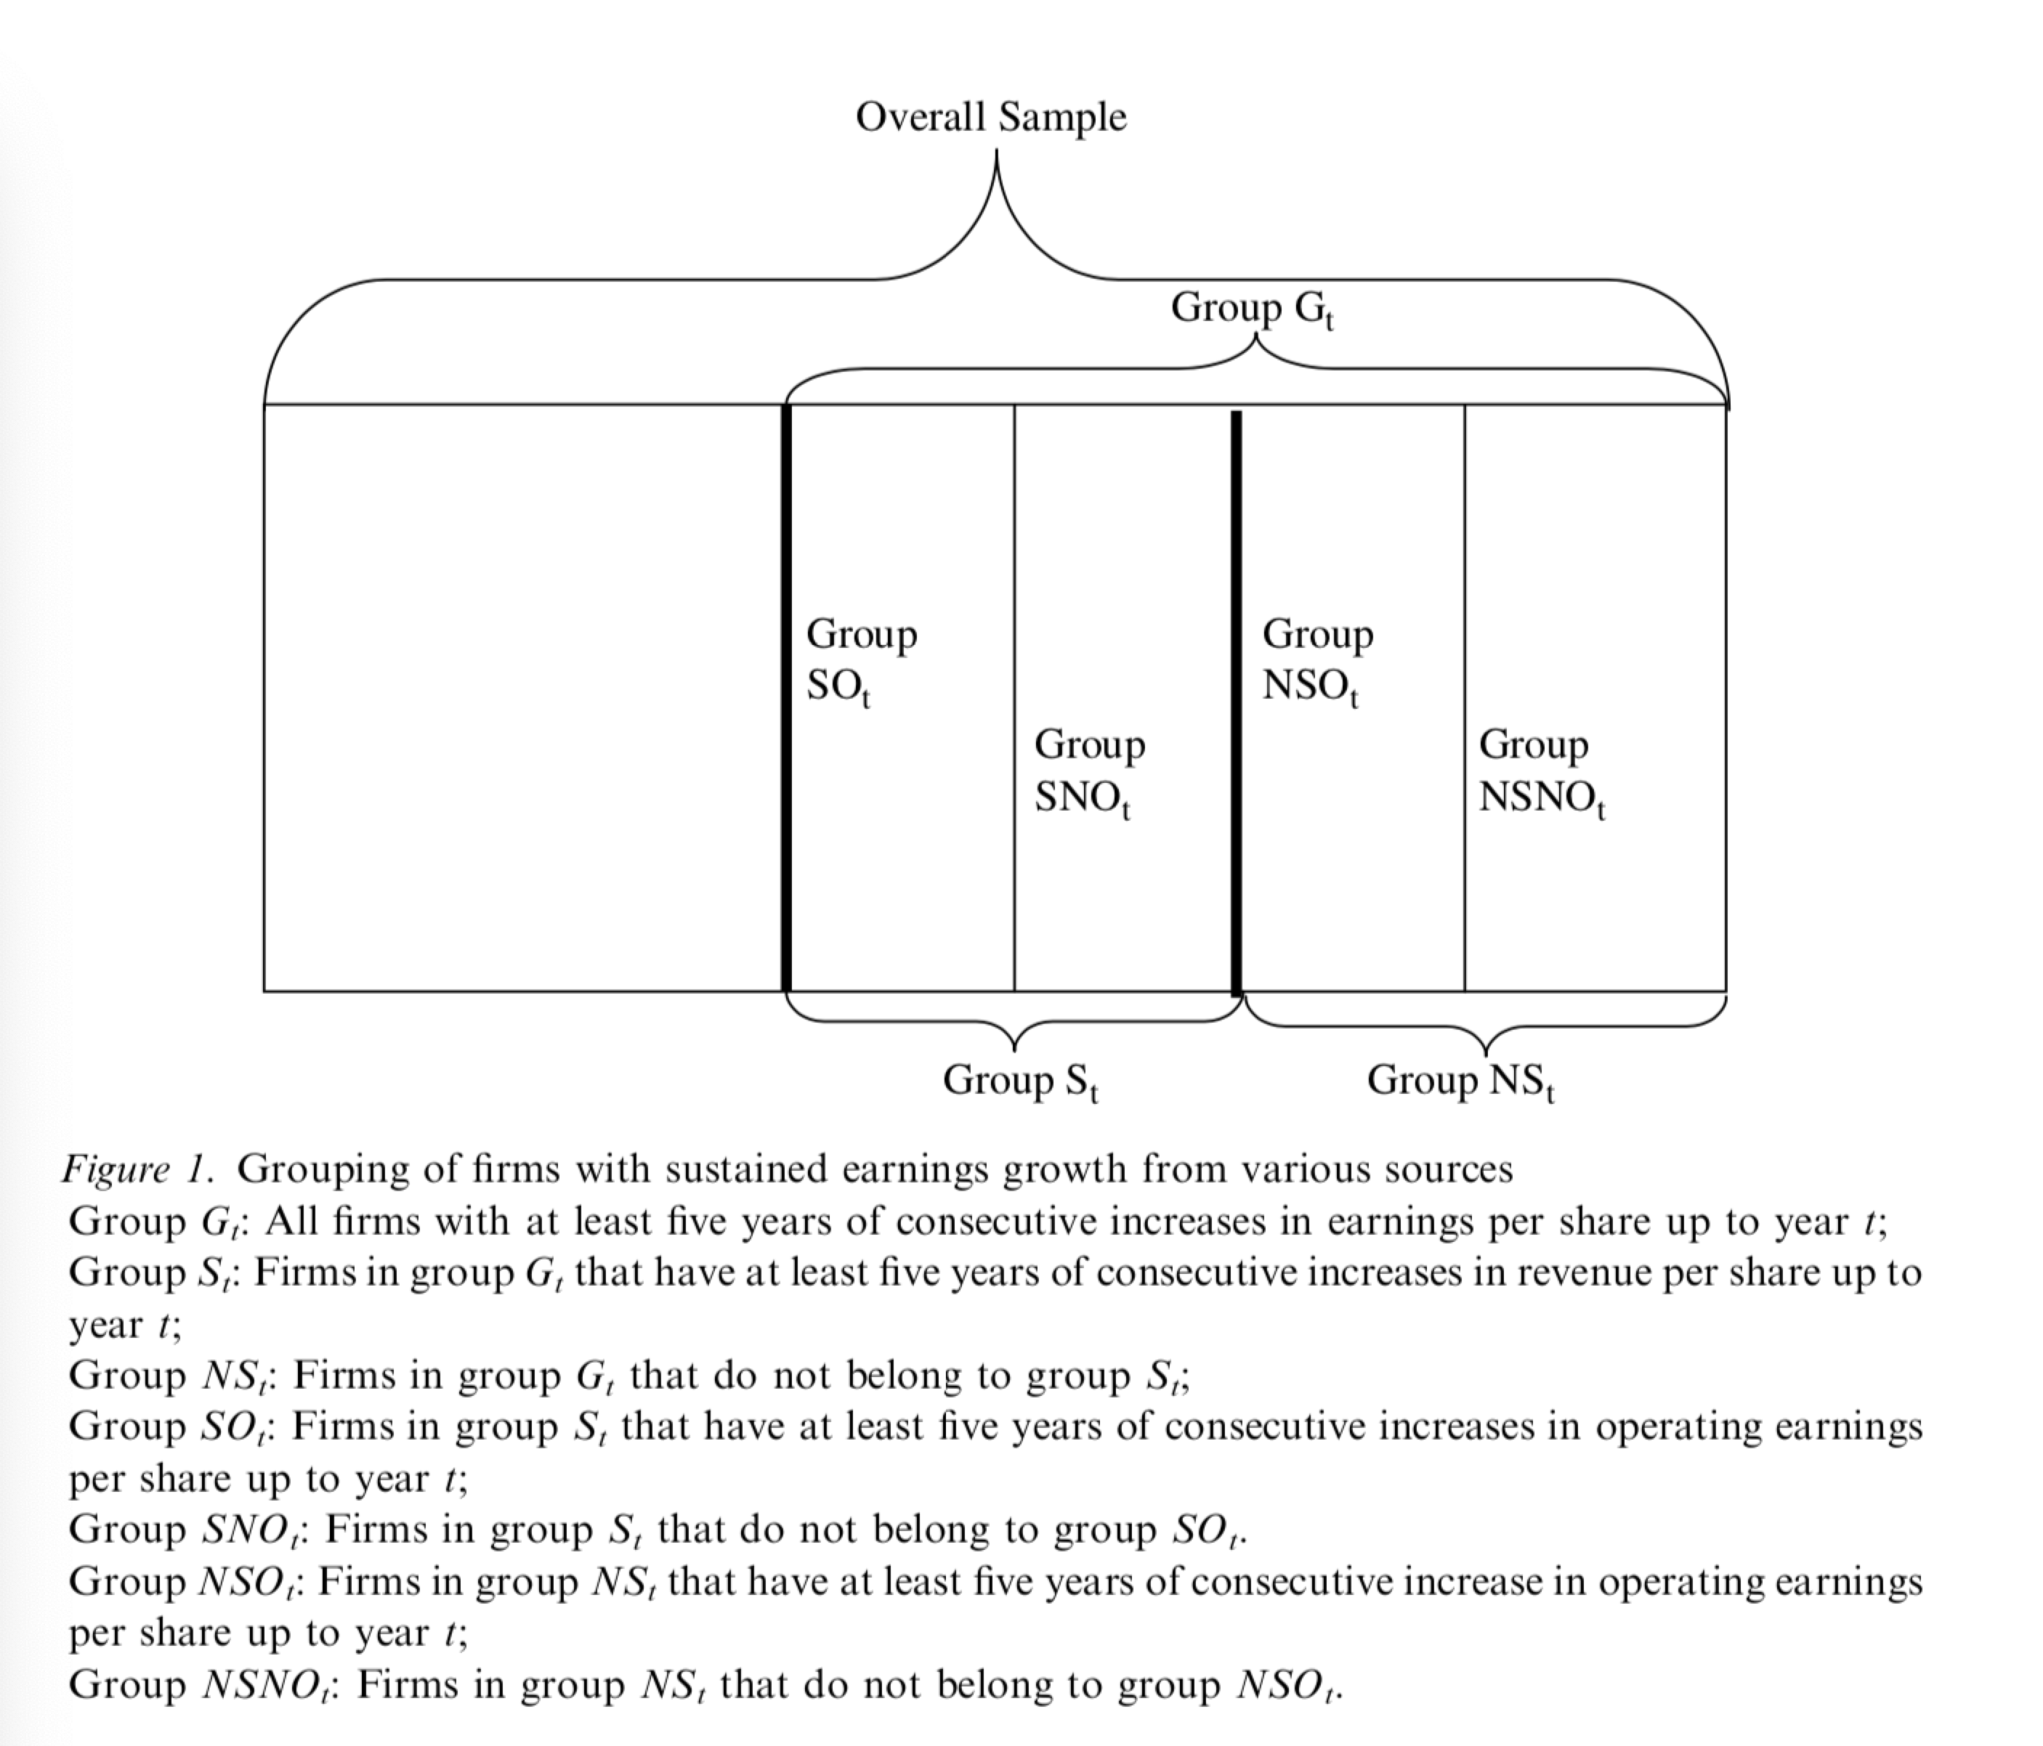
Define Different Groups of Firms

Slide 7
Tests to be covered
Test on Earning Quality
Test on Earning Response Coefficients
Earning Management and Future Operating Performance
Earning Persistence
Earning Growth Persistence
Price Level Models
Return Models

Slide 8
Test on Earning Quality: Earnings Management, Future Operating Performance
Earning Management: examine total accruals, working capital accruals and abnormal accruals, as well as special items and share repurchases
Future Operating Performance: long-term earnings growth forecasts, realized future return on assets and the frequency of firms that continue to have earnings increases
Notes:
Total Accruals are measured as the difference between income before extraordinary items (#123) and operating cash flow (#308) net of cash flow from extraordinary items (#124) from the cash flow statement.
Working capital accruals (WC Accruals) are computed by adding depreciation expenses (#14) to total accruals.
Abnormal Accruals are estimated as the residuals from the cross-sectional modified Jones (1991) model.7

Slide 9
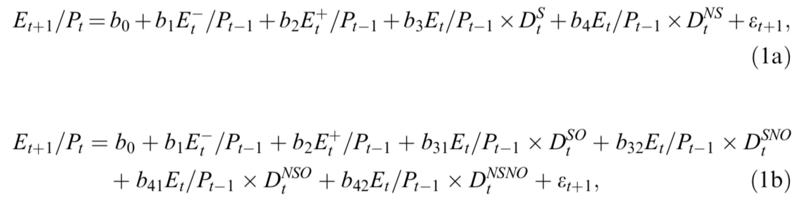
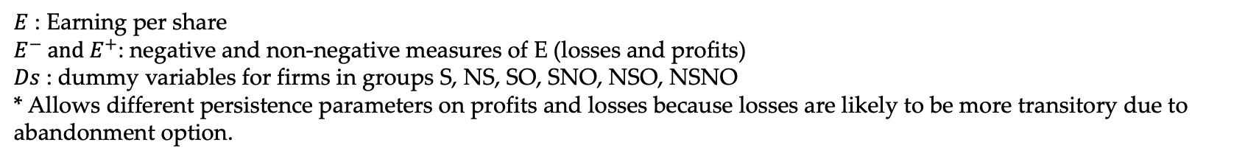
Test on Earning Quality: Earning Persistence: Freeman et al. (1982)
$E$ : Earning per share
$E^{−} and E^{+}$: negative and non-negative measures of E (losses and profits)
$Ds$ : dummy variables for firms in groups S, NS, SO, SNO, NSO, NSNO
* Allows different persistence parameters on profits and losses because losses are likely to be more transitory due to abandonment option.
Notes:
Model (1a): examines the two broad groups S and NS
Model (1b): examines the finer groups SO, SNO, NSO, NSNO

Slide 10
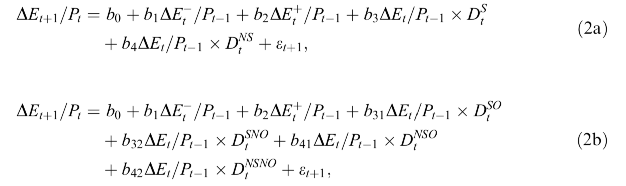
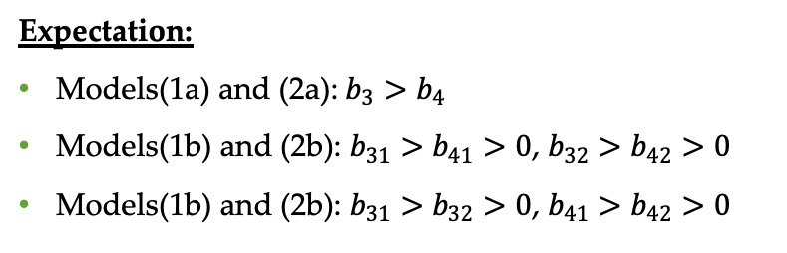
Test on Earning Quality: Persistence of Earning Growth: Dechow et al. (1998)
Expectation:
Models(1a) and (2a):$b_{3}>b_{4}$
Models(1b) and (2b): $b_{31}>$ $b_{41}>0$, $b_{32}>b_{42}>0$
Models(1b) and (2b): $b_{31}>$ $b_{32}>0$, $b_{41}>b_{42}>0$
Notes:
Model 1a1b look at the persistence of earnings levels, Dechow et al. shows that earnings changes are on average negatively serially correlated, suggesting that the earnings process is mean reverting. --> expect that earnings growth is less likely to reverse when it is sustained through revenue increases

Slide 11
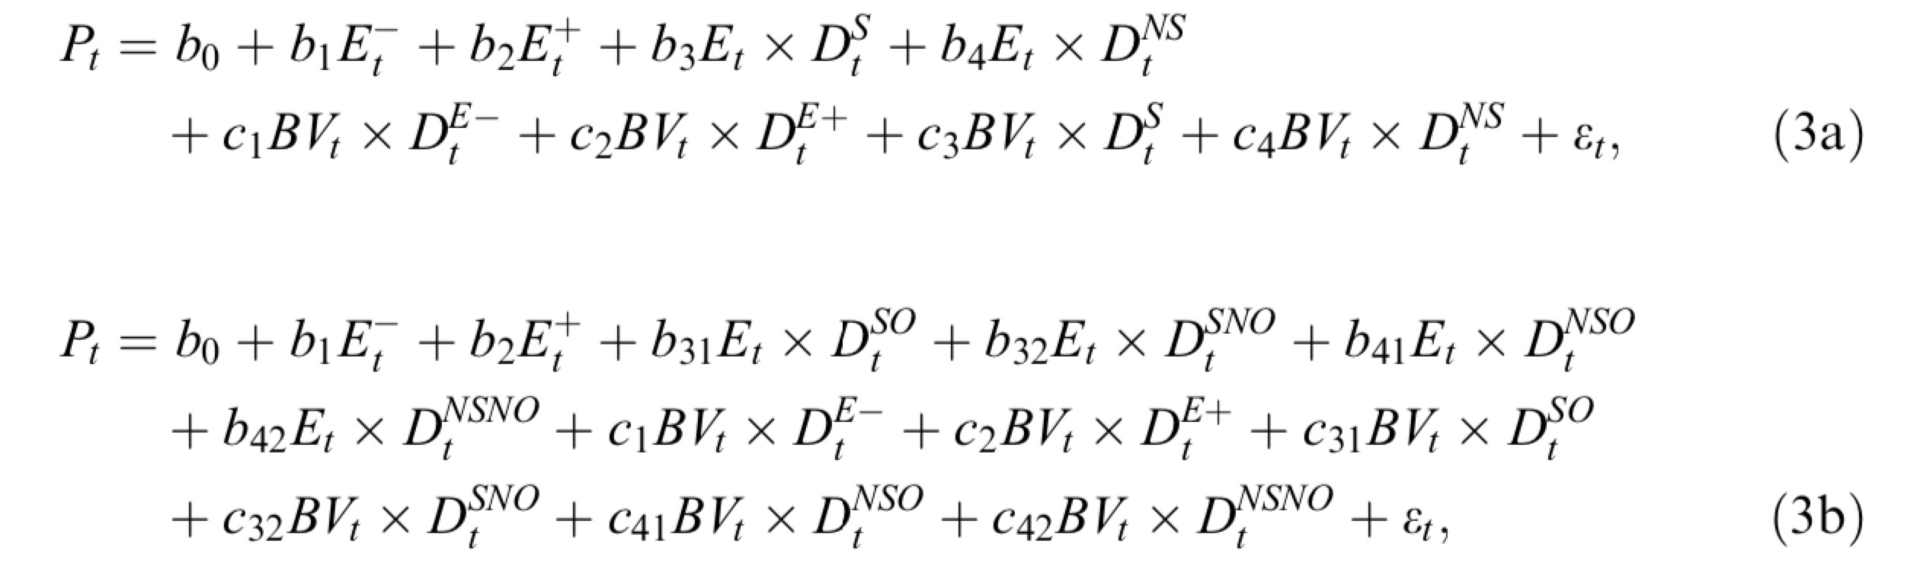
Test on Earnings Response Coefficients Price Level Models
Following prior studies, use variations of the Ohlson(1995) model that relates stock prices to earnings and book value.
One implication of valuation model Ohlson (1995) is that a higher weight on earnings corresponds to a lower weight on book value.
Allow response coefficients for both earnings and book value to vary among firms with positive and negative earnings.

Slide 12
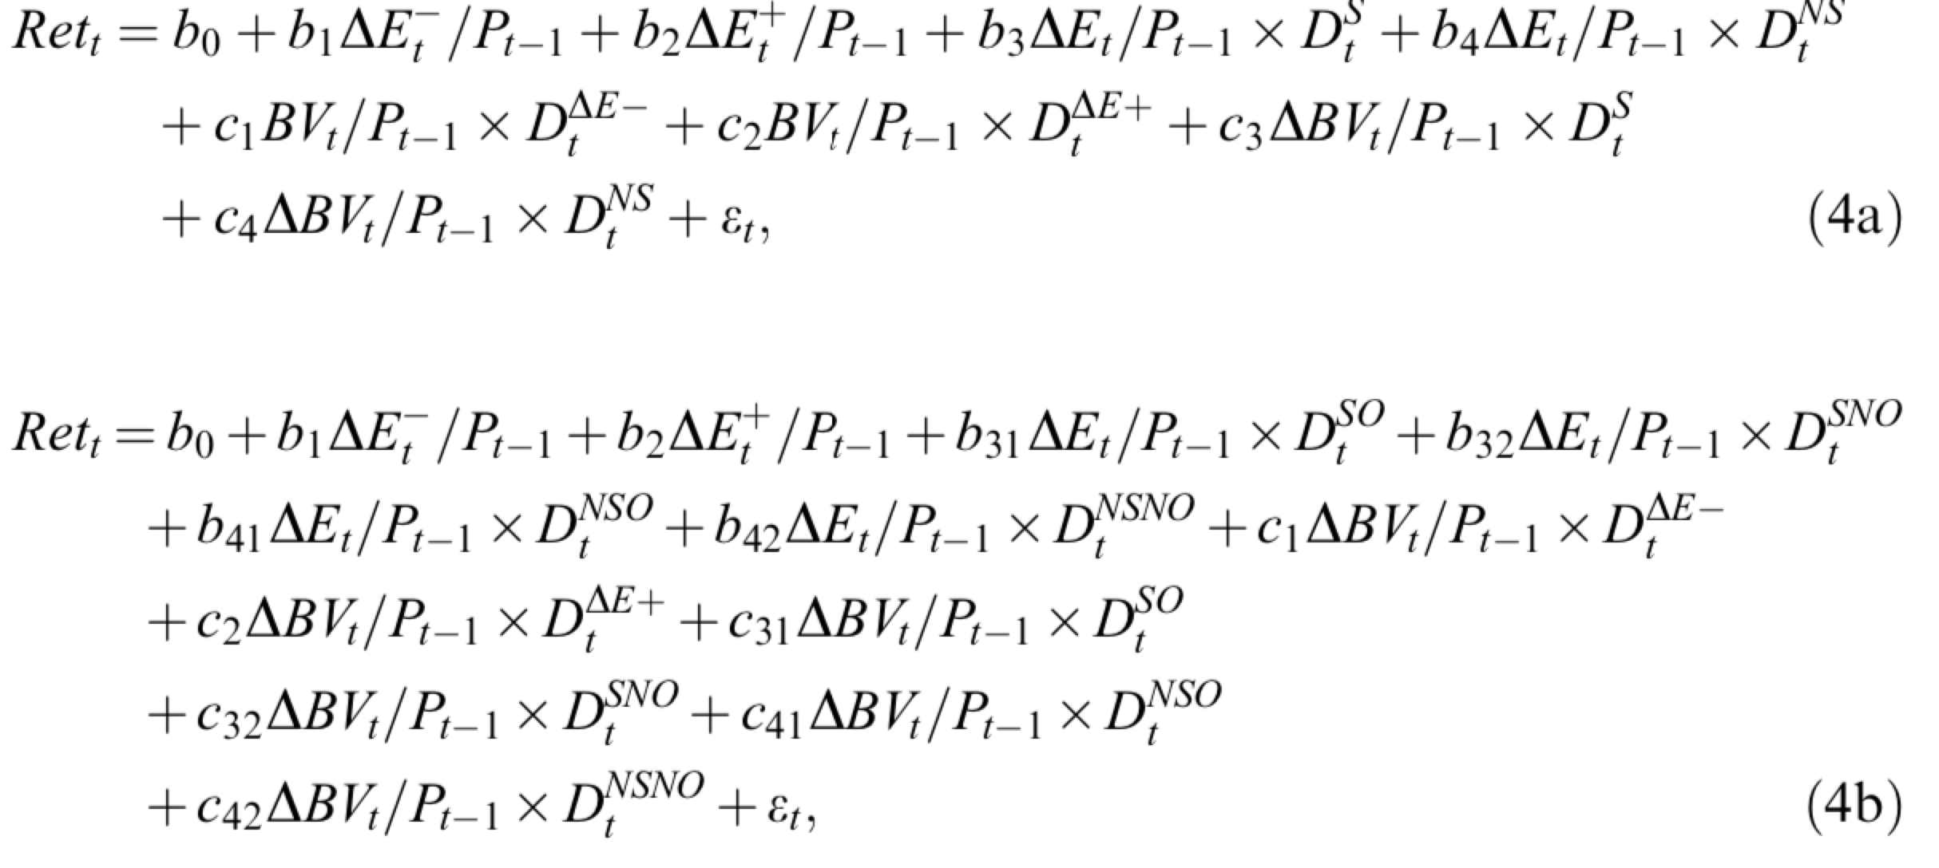
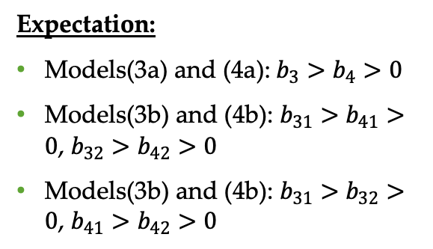
Test on Earnings Response Coefficients Return Models
Expectation:
Models(3a) and (4a):$b_{3}>b_{4}>0$
Models(3b) and (4b): $b_{31}>$ $b_{41}>0$, $b_{32}>b_{42}>0$
Models(3b) and (4b): $b_{31}>$ $b_{32}>0$, $b_{41}>b_{42}>0$
Notes:
Ret is the compounded stock return from the fourth month of fiscal year t to the third month after the year-end
* Use price level models with return models because together they prove a complimentary set of results.

Slide 13
Sample Selection
Initial sample consists of all firms covered on Compustat, active and inactive, from 1980 to 2000.
A firm is included only if it has at least five consecutive years of accounting data
Allows calculation of sustained growth
Avoids selecting recent IPO forms with high growth potential or high risks
Remove top and bottom 1% of observations for stock prices/returns, book value/book value changes and earnings/earnings changes to mitigate the potential effect of outliers
Final Sample Size for Price level regression: 94,687, for Returns regression: 92,783

Slide 14
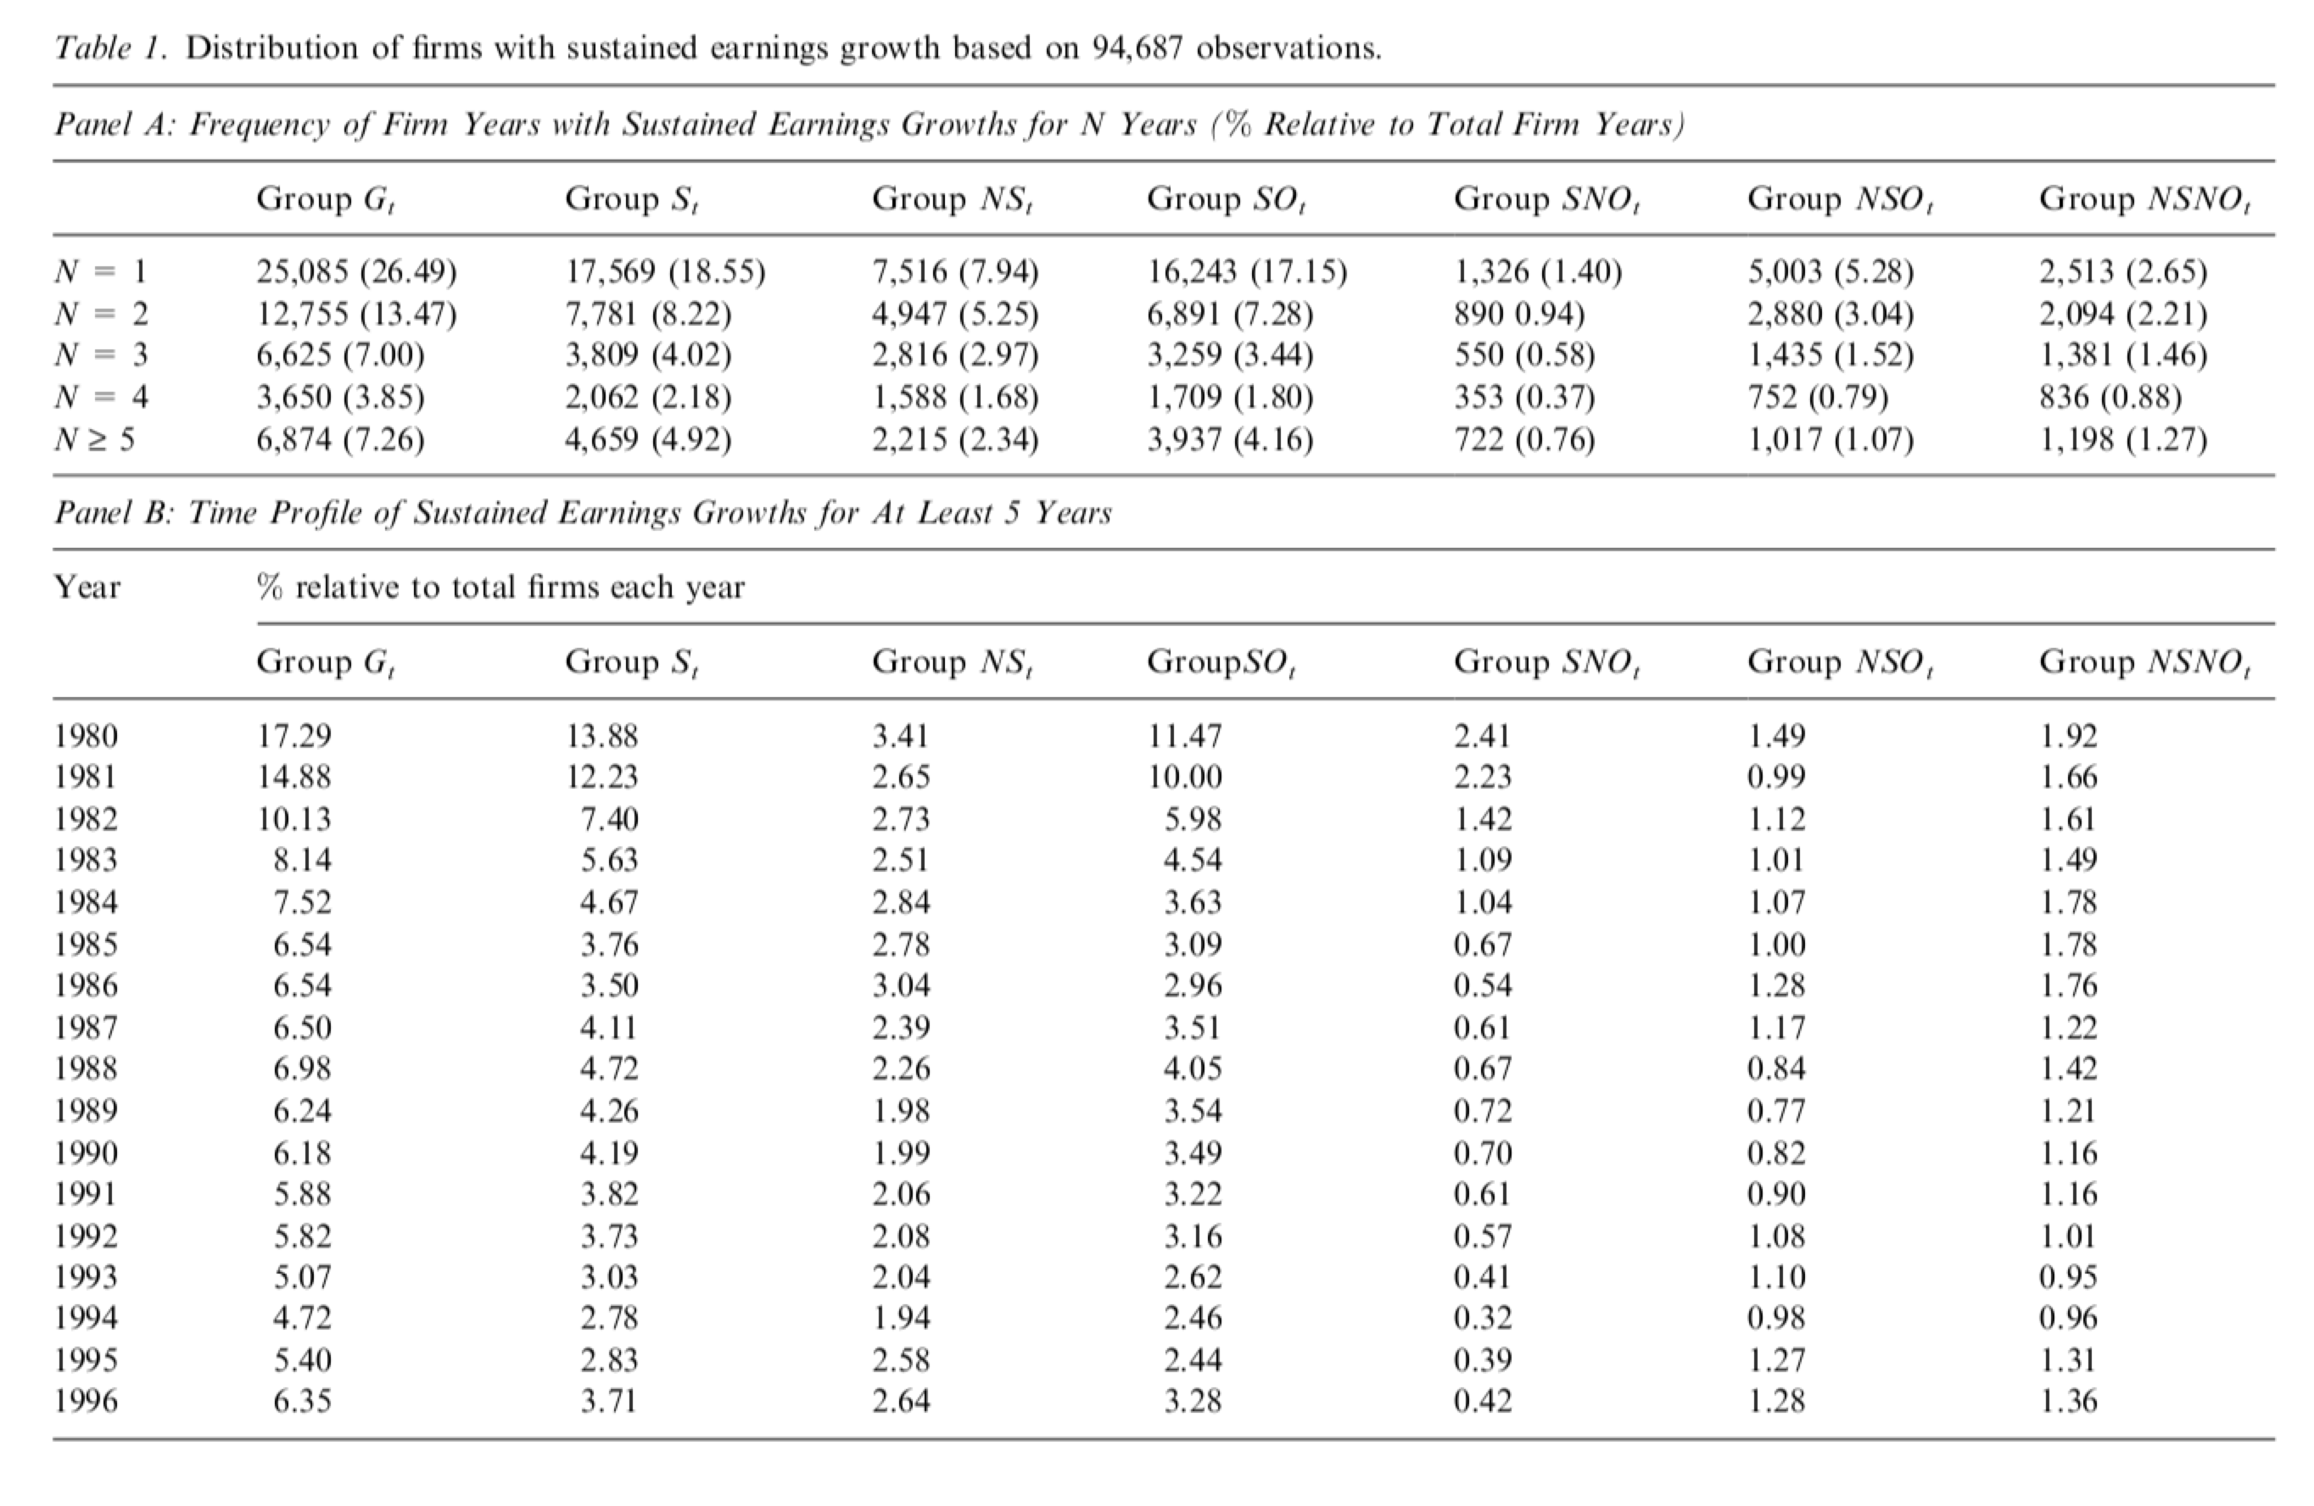
Descriptive Statistics
58.07% of the firms in our sample have earnings increases, consistent with 57.43% in Barth et al.(1999)
For those firms that have both earnings and revenue growth, the majority also has concurrent operating earnings increases (SO).
Patterns for various groups are very similar, so no evidence that particular groups are concentrated in certain years.
Untabulated results shows that the industry distribution patterns for various groups are also similar, so the effect is not industry-specific.

Slide 15
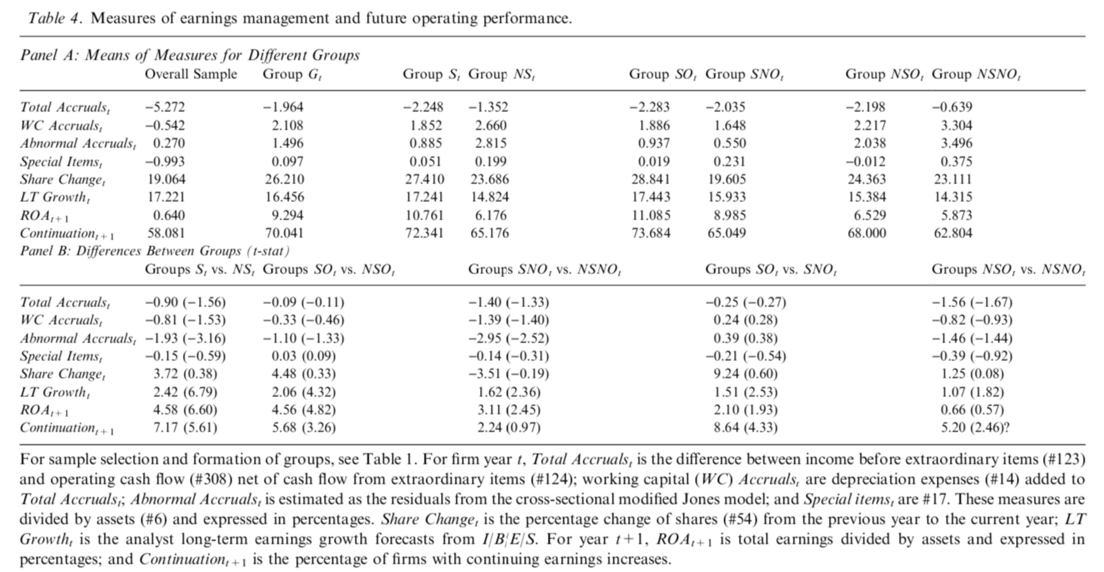
Results on Earnings Management and Future Performance
Total Accruals and WC Accruals are lower for Group S than Group NS, with differences both significant at less than 7% level.
Abnormal Accruals difference is also significant at less than 1%
No big difference in special items
Firms in Group S are less likely to use revenue-increasing accruals than firms in Group NS.
No evidence to suggest that revenue-increasing firms achieve earnings growth through more aggressive earnings management.

Slide 16
Results on Earnings Management and Future Performance
Share Repurchase: firms with sustained earnings growth tend to increase their net shares even more than average firms
Future Performance: firms with sustained earnings growth have higher subsequent returns and are more likely to continue earnings increases in the following year.
Notes:
Share Repurchase: Share changes
Future Performance: ROA & Continuation

Slide 17
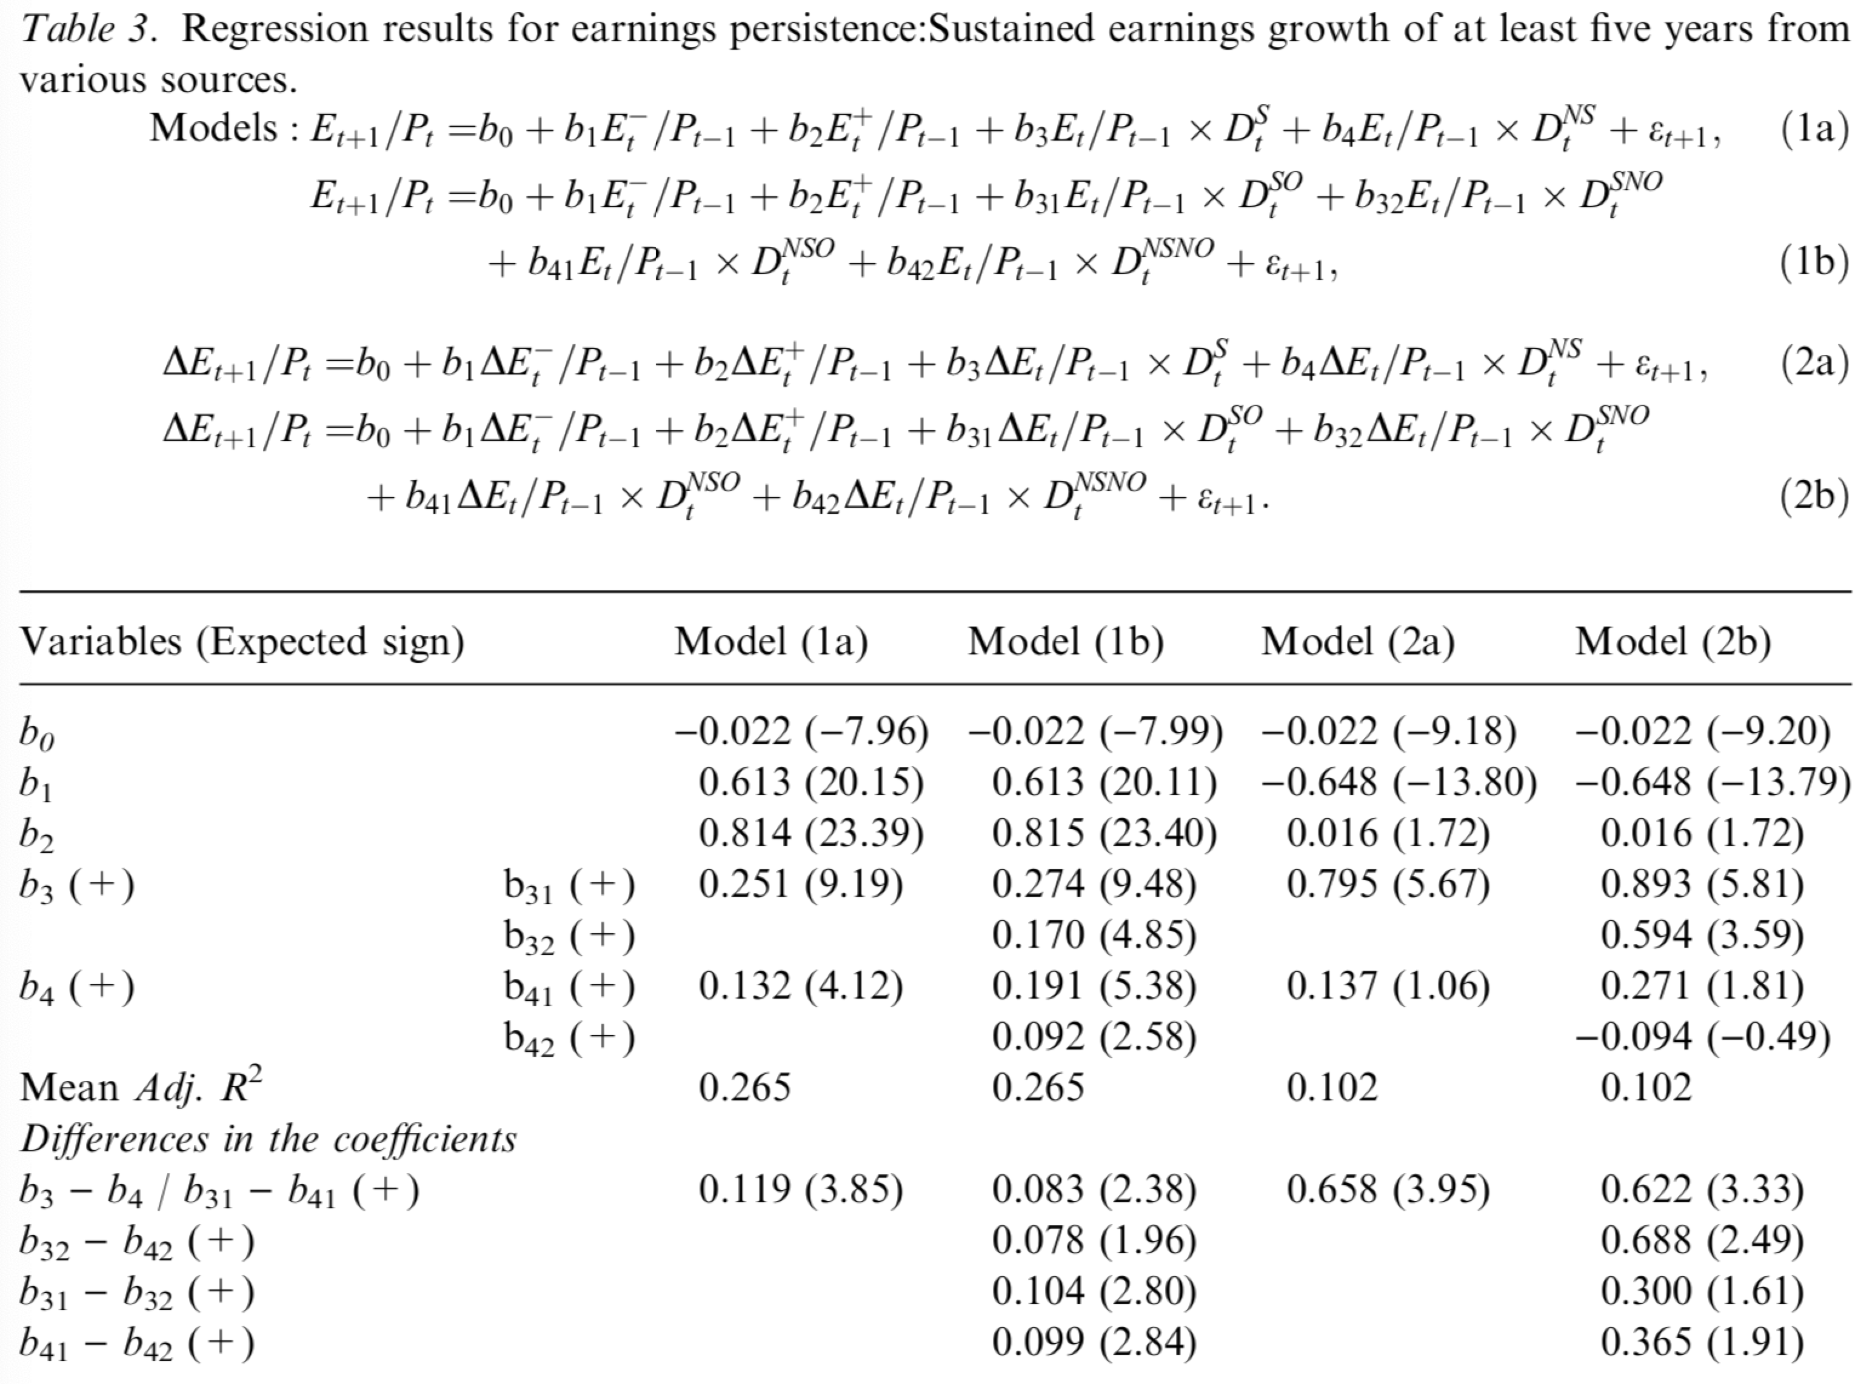

Results on Earning Persistence
The incremental persistence parameters are the highest for SO($b_{31})$ and lowest for NSNO($b_{42})$
Both revenue-increasing groups SO and SNO have higher persistence parameters then cost-reduction groups NSO and NSNO.
In both revenue-increasing and cost-reduction firm groups, the subgroups with operating earnings increases have higher persistence parameters than those without

Slide 18
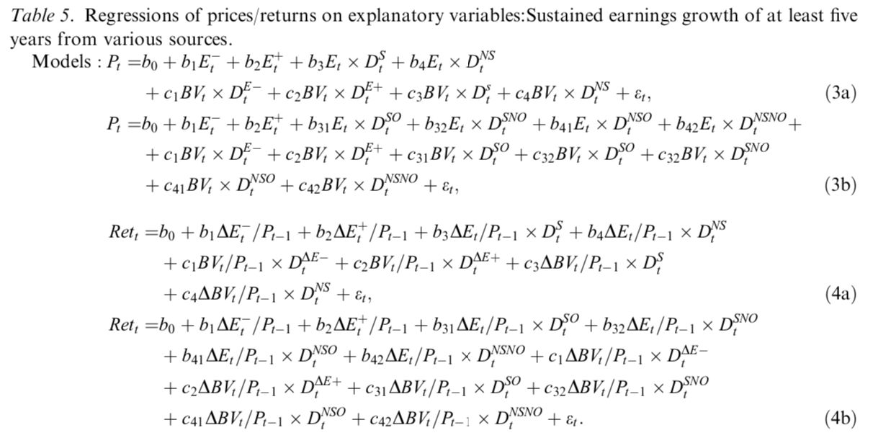
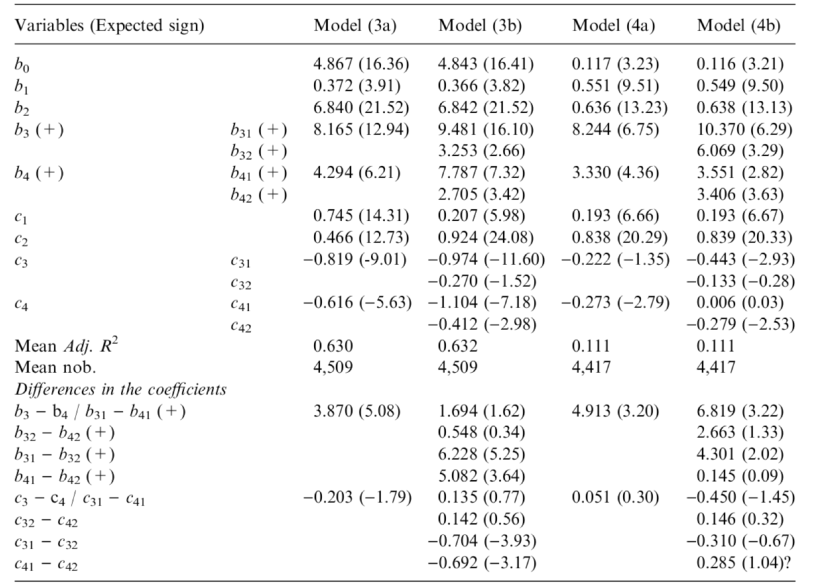
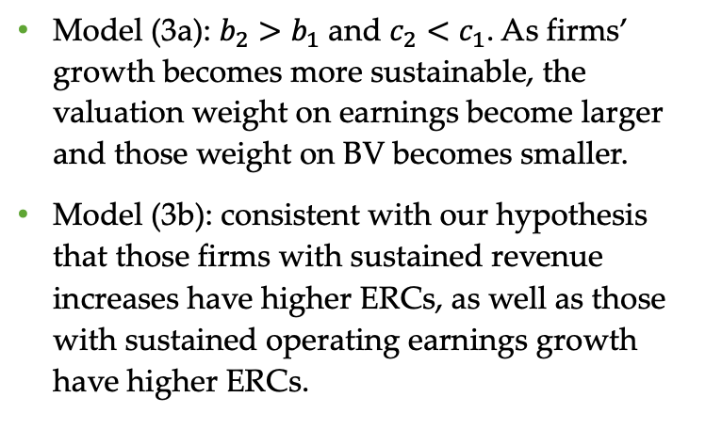
Results on Earning Response Coefficients
Model (3a): $b_{2}>b_{1}$ and $c_{2}<c_{1}$. As firms’ growth becomes more sustainable, the valuation weight on earnings become larger and those weight on BV becomes smaller.
Model (3b): consistent with our hypothesis that those firms with sustained revenue increases have higher ERCs, as well as those with sustained operating earnings growth have higher ERCs.
Notes:
For our variables of interest, the incremental ERC (b3) for group S is 8.165 while the incremental ERC (b4) for group NS is 4.294. which is only about one half of b3. The difference of 3.870 is highly significant (t 1⁄4 9.51). As expected, the incremental BVRCs for both groups are negative (c3 1⁄4 )0.819, c4 1⁄4 )0.616, t < )5.6). In fact, the magnitude of the negative incremental BVRCs is so large that the total BVRCs become negative, especially for group S (c2 + c3 1⁄4 )0.353, c2 + c4 1⁄4 )0.150) (also see Burgstahler and Dichev, 1997; Chen and Zhang, 2002).8 Overall, the results suggest that as firms’ growth becomes more sustainable, the valuation weight on earnings becomes larger and the valuation weight on book value becomes smaller or even negative.

Slide 19
Results on Earning Response Coefficients
Model (4a):b1 and b2 are similar. But BV change is higher when earning changes are positive than negative. Also, incremental ERC for Group S is significantly larger than Group NS
Model (4b): Group SO has the highest incremental ERC so far and most negative incremental BVRC

Slide 20
Additional Test
Sensitivity Check
Level Models: Use asset per share or lagged price to deflate all variables
Return Models: Use market-adjusted returns instead of raw returns
Include earning levels and earning changes as explanatory variables
Use operating earnings after depreciation instead of operating earnings before depreciation
Result: None of the results are qualitatively affected.

Slide 21
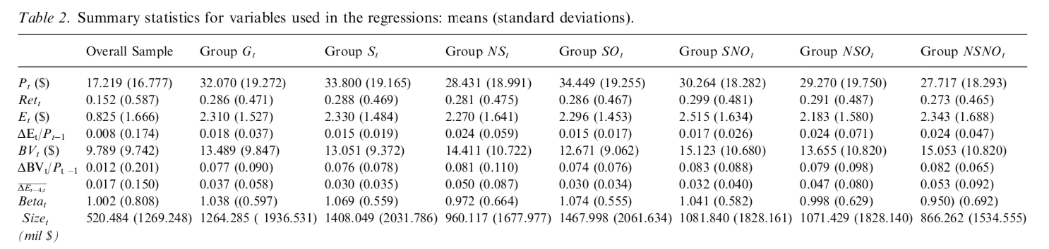
Additional Test
Explore whether the coefficient differentials in Table 5 are driven by factors other than sources of earnings growth
Differences in growth rates
Risks
Size or industry effects
Calculate past five-year avg earnings growth rate, equity betas, and firm size for various groups
Notes:
Average growth rates for Group S are no higher than Group NS
Equity beta are similar across groups
So higher ERCs for group S is not because of higher prior growth rates or higher risks
But firms in Group S are on average larger than those in Group NS. → Make subsamples based on median size and estimate regressions for each subsample → We found that ERC differentials between groups are almost the same.
Conduct another regressions within broadly defined industries → higher ERCs for group S than NS. Most of differences in ERCs are significant.

Slide 22
Additional Test
Examine how ERCs change for varying lengths of growth
Estimate Model (3a) and (4a) for various groups that have earnings growth sustained over 1-5 years
Found that incremental ERCs increase when the length of earnings strings increase
Incremental BVRCs decrease correspondingly
ERCs for Group S always dominate those of Group NS for any length of earnings growth

Slide 23
Summary of Results
Consistent with the predictions
Earnings are of higher quality for the revenue-increasing firms than cost-reduction firms
Earnings for revenue-increasing firms are more persistent and are less likely to be managed through accounting accruals, special items or share repurchases
Revenue-increasing firms have higher future operating performance
ERCs for revenue-increasing firms are higher, accompanied by lower response coefficients on book value, which is consistent with Ohlson model
Earnings quality and ERCs are highest when sustained increases in earnings are supported by sustained increases in both revenues and operating earnings

Slide 24
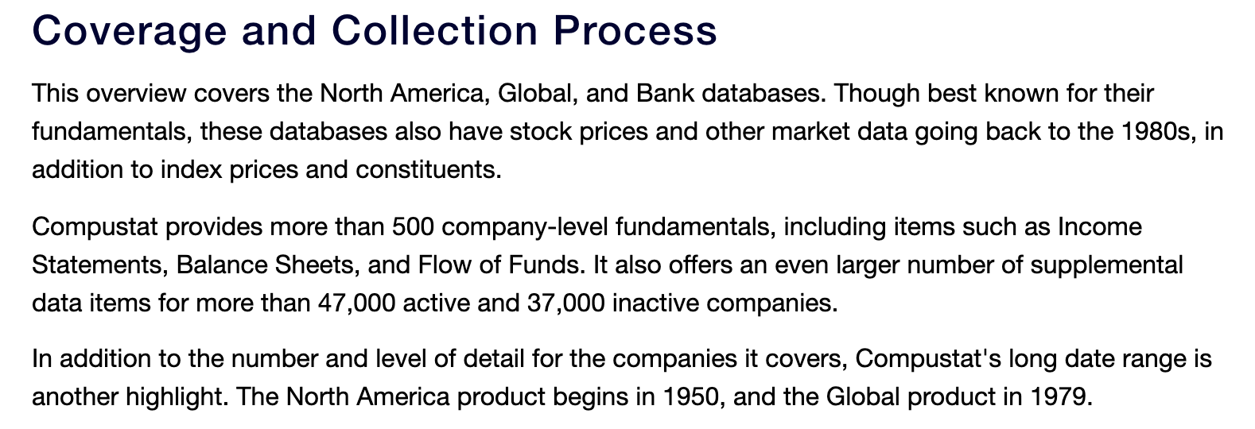
My View
Overall, very comprehensive
Link between business strategy analysis and financial statement analysis
Confusion:
Final Sample Size for Price level regression: 94,687, for Returns regression: 92,783
What if a company has two periods of sustained earnings increase in the 20-years period?

Slide 25
My View
Significance and Explaining Power

