Slide 1
Randomization and the American Put
Author: Peter Carr
Presenter: Ken Ngo - 467632

Slide 2
Outline
1. American put in Black-Scholes
2. Randomization of the American put with Exponential distribution
*on non-dividend-paying stock*
3. Randomization of the American put with Erlang distributed maturity
*on non-dividend-paying stock*
4. Implementation
5. Dividend and American options
6. Summary

Slide 3
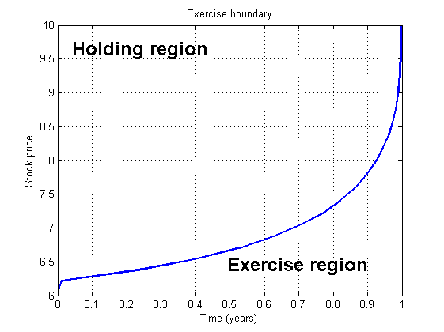
Brief catch-up
- Stopping time: stopping the first time the value of the option agrees with its intrinsic value. Optimal exercise time.
- Critical stock price: stock price that makes the investor indifferent between holding an option until expiration, and exercising the option
- Exercise boundary:

Slide 4
1. American put in Black-Scholes
- Over the option's life [0, T], the economy is described by frictionless markets, no arbitrage, a constant riskless rate r > 0
- No dividends from the underlying stock
- Underlying spot price process {St, t ϵ E (0, T)} is a geometric Brownian motion with a constant volatility rate σ > 0
- As the maturity is shortened, the alive American put value falls, while the exercise value remains constant

Slide 5

1. American put in Black-Scholes
a ᴧ b = min(a, b)
$τ_{B}$ is the first passage time from S to an exercise boundary B(t) with t ϵ [0, T]

Slide 6
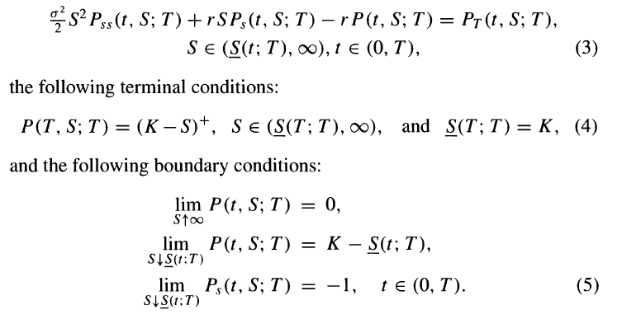
1. American put in Black-Scholes
McKean (1965) proved that the alive American put value and exercise boundary jointly solve a free boundary problem, consisting of the Black-Scholes PDE:

Slide 7
Unfortunately there is no known exact and completely explicit solution to either the optimal stopping problem of Equation (1) or to the free boundary problem of Equation (3)
→ Randomization

Slide 8
Randomization process
1. Randomize a parameter by assuming a plausible distribution for it.
2. Calculate the expected value of the dependent variable in this random parameter setting.
3. Let the variance of the distribution governing the parameter approach zero, holding the mean constant at the fixed parameter value
Parameter chosen
Initial stock price / Strike price / Initial time / Maturity date

Slide 9

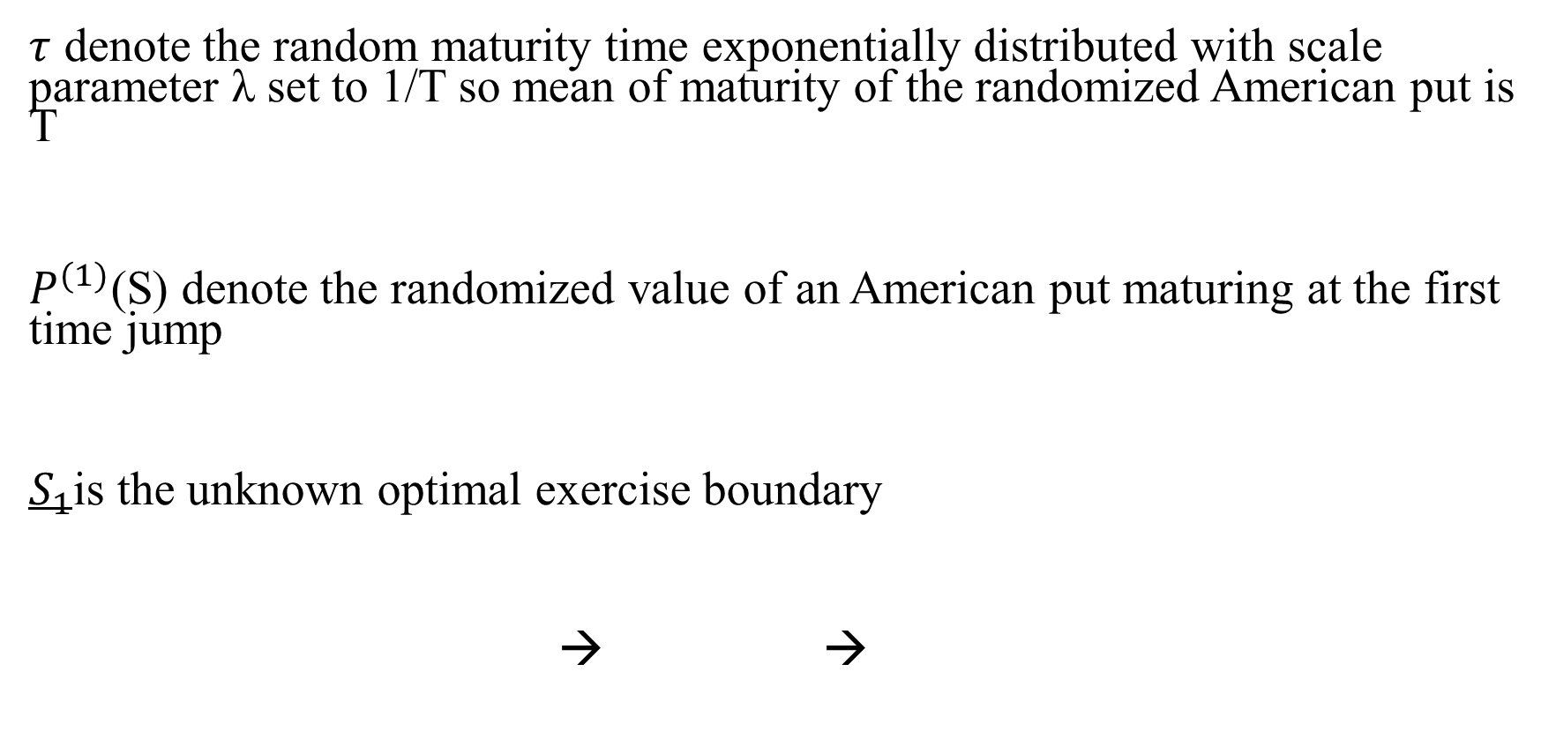
2. Randomization with Exponential distribution
$τ$ denote the random maturity time exponentially distributed with scale parameter λ set to 1/T so mean of maturity of the randomized American put is T
$P^{(1)}$(S) denote the randomized value of an American put maturing at the first time jump
$S_{1}$is the unknown optimal exercise boundary
→ →
time-dependent exercise boundary of a true American put becomes flat when we randomize the maturity

Slide 10

2. Randomization with Exponential distribution
Rewrite Equation (7)
(6) and (8) imply the following relationship between random and fixed maturity put values
D(O, S; t; B) is the initial value of a down-and-out put with fixed maturity t, out barrier B, and rebate K - B

Slide 11
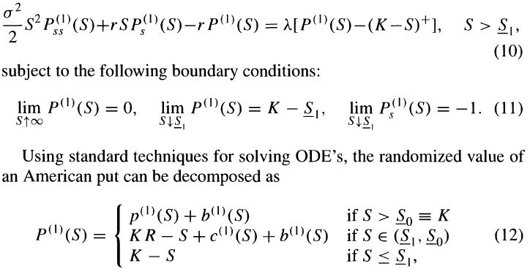
2. Randomization with Exponential distribution
Laplace-Carson transform equation 9 PDE to obtain ODE:
p(l)(S) is the randomized value of the European put at the first jump time
b(l) (S) is the present value of interest received below the critical SI until the first jump time
c(l) (S) is the randomized value of the European call at the first jump time

Slide 12
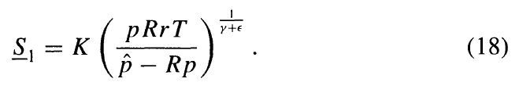
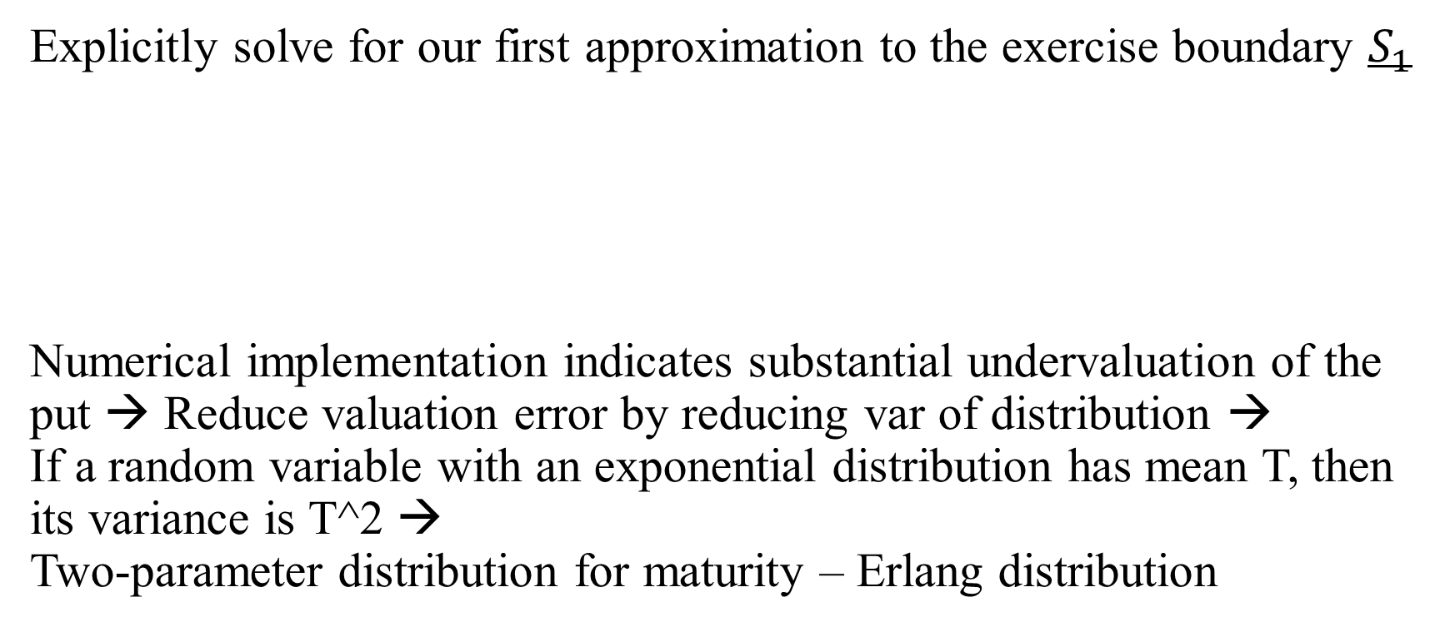
2. Randomization with Exponential distribution
Explicitly solve for our first approximation to the exercise boundary $S_{1}$
Numerical implementation indicates substantial undervaluation of the put → Reduce valuation error by reducing var of distribution →
If a random variable with an exponential distribution has mean T, then its variance is T^2 →
Two-parameter distribution for maturity – Erlang distribution

Slide 13

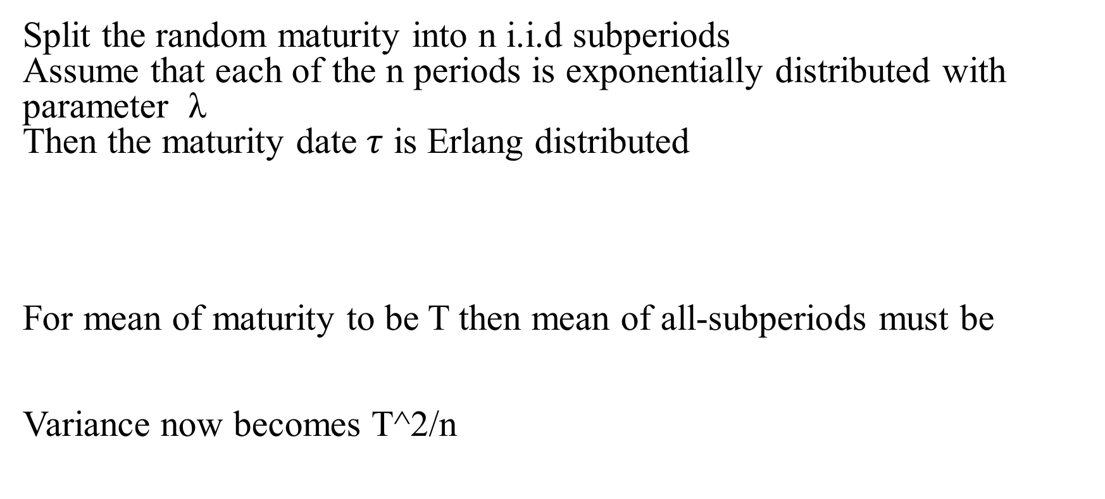
3. Randomization with Erlang distribution
Split the random maturity into n i.i.d subperiods
Assume that each of the n periods is exponentially distributed with parameter λ
Then the maturity date $τ$ is Erlang distributed
For mean of maturity to be T then mean of all-subperiods must be
Variance now becomes T^2/n

Slide 14

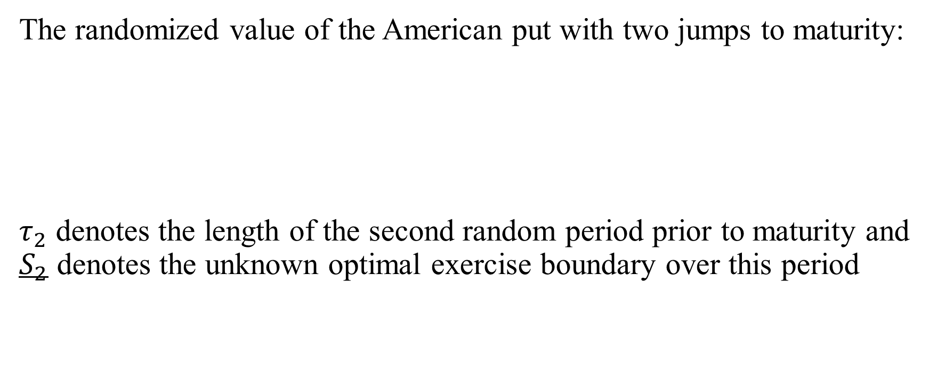
3. Randomization with Erlang distribution
The randomized value of the American put with two jumps to maturity:
$τ_{2}$ denotes the length of the second random period prior to maturity and $S_{2}$ denotes the unknown optimal exercise boundary over this period

Slide 15
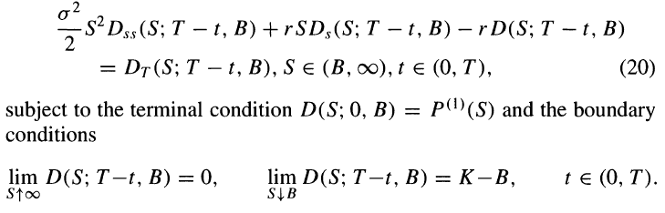

3. Randomization with Erlang distribution
Let D(S; T - t, B) denote the time t value of a down-and-out put with fixed maturity T, out barrier B, and which pays a rebate of K - B at the first passage time to B, if this occurs before T, and which pays $P^{(1)}$ ($S_{T}$) at T otherwise. Then, D(S; T - t, B) satisfies the Black-Scholes PDE

Slide 16

3. Randomization with Erlang distribution
The randomized value of the American put maturing after two more jumps of the Poisson process is related to this fixed maturity claim by

Slide 17
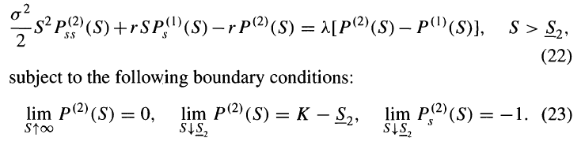
3. Randomization with Erlang distribution
Laplace-Carson transforms of both sides of the PDE
This simpler free boundary problem can be solved analytically

Slide 18
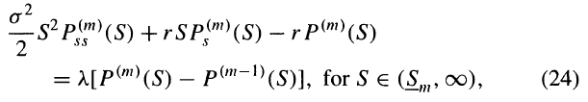
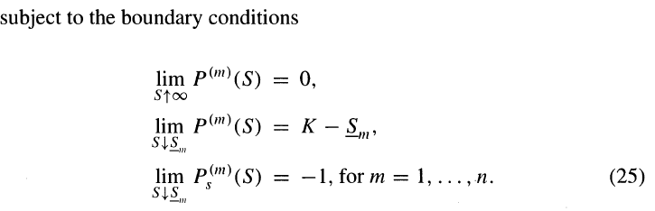

3. Randomization with Erlang distribution
Move to the general case $P^{\left(m\right)}(S)$and $S_{m}$ jointly solve the following sequence of free boundary problem

Slide 19
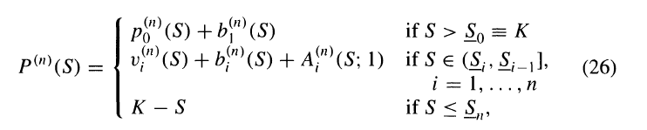
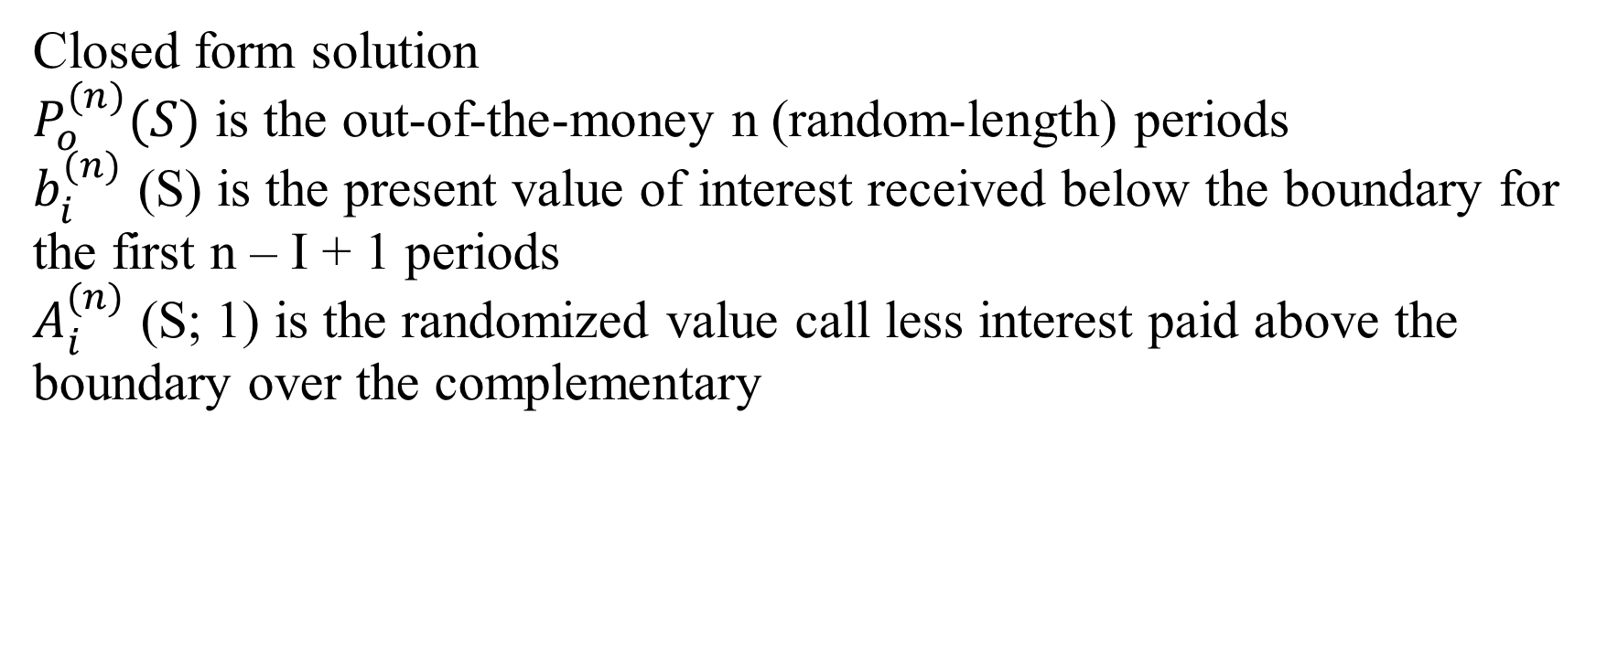
3. Randomization with Erlang distribution
Closed form solution
$P_{o}^{(n)}(S)$ is the out-of-the-money n (random-length) periods
$b_{i}^{(n)}$ (S) is the present value of interest received below the boundary for the first n – I + 1 periods
$A_{i}^{(n)}$ (S; 1) is the randomized value call less interest paid above the boundary over the complementary

Slide 20
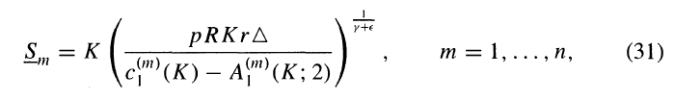


3. Randomization with Erlang distribution
Explicit solution
Since $A^{(m)}$ in Equation (31) depends on $S_{m−1}$ to $S_{1}$ , the critical stock prices must be solved recursively,

Slide 21


4. Implementation
Denote our approximation [Equation (26)] by a function $\hat{P}$(∆) of the mean period length ∆. Richardson extrapolation can be used when the approximation can be adequately described by the first N terms in a Taylor series expansion about the origin:

Slide 22
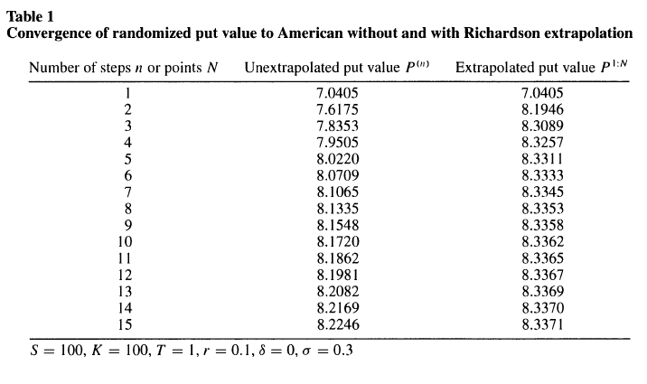
4. Implementation
Value based on the binomial method with 2000 time steps appears to be 8.3378.

Slide 23

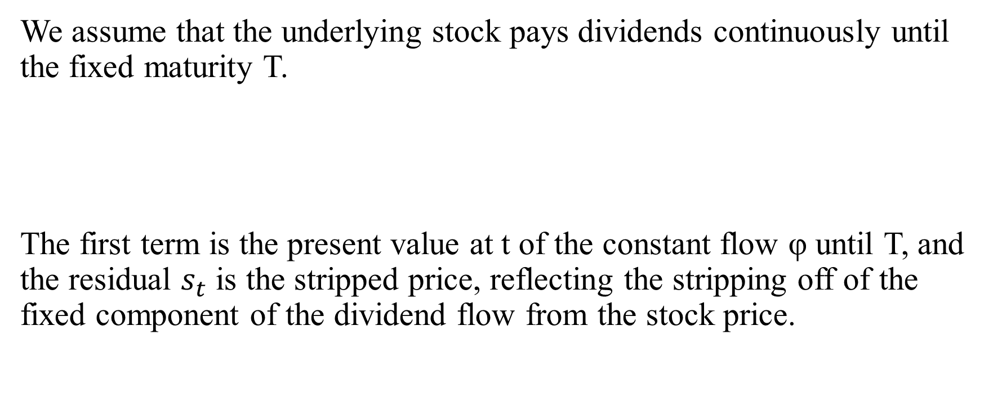
5. Dividend and American options
We assume that the underlying stock pays dividends continuously until the fixed maturity T.
The first term is the present value at t of the constant flow φ until T, and the residual $s_{t}$ is the stripped price, reflecting the stripping off of the fixed component of the dividend flow from the stock price.

Slide 24
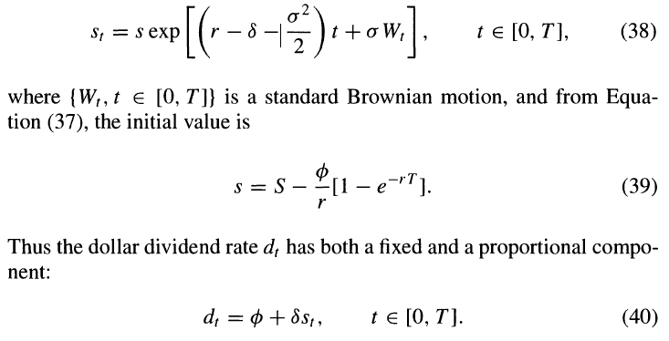

5.1 Dividend and American put
We assume that the risk-neutralized process for the stripped price {$s_{t}$, t ϵ (0, T)} is the following geometric Brownian motion:

Slide 25
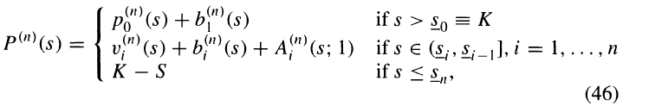
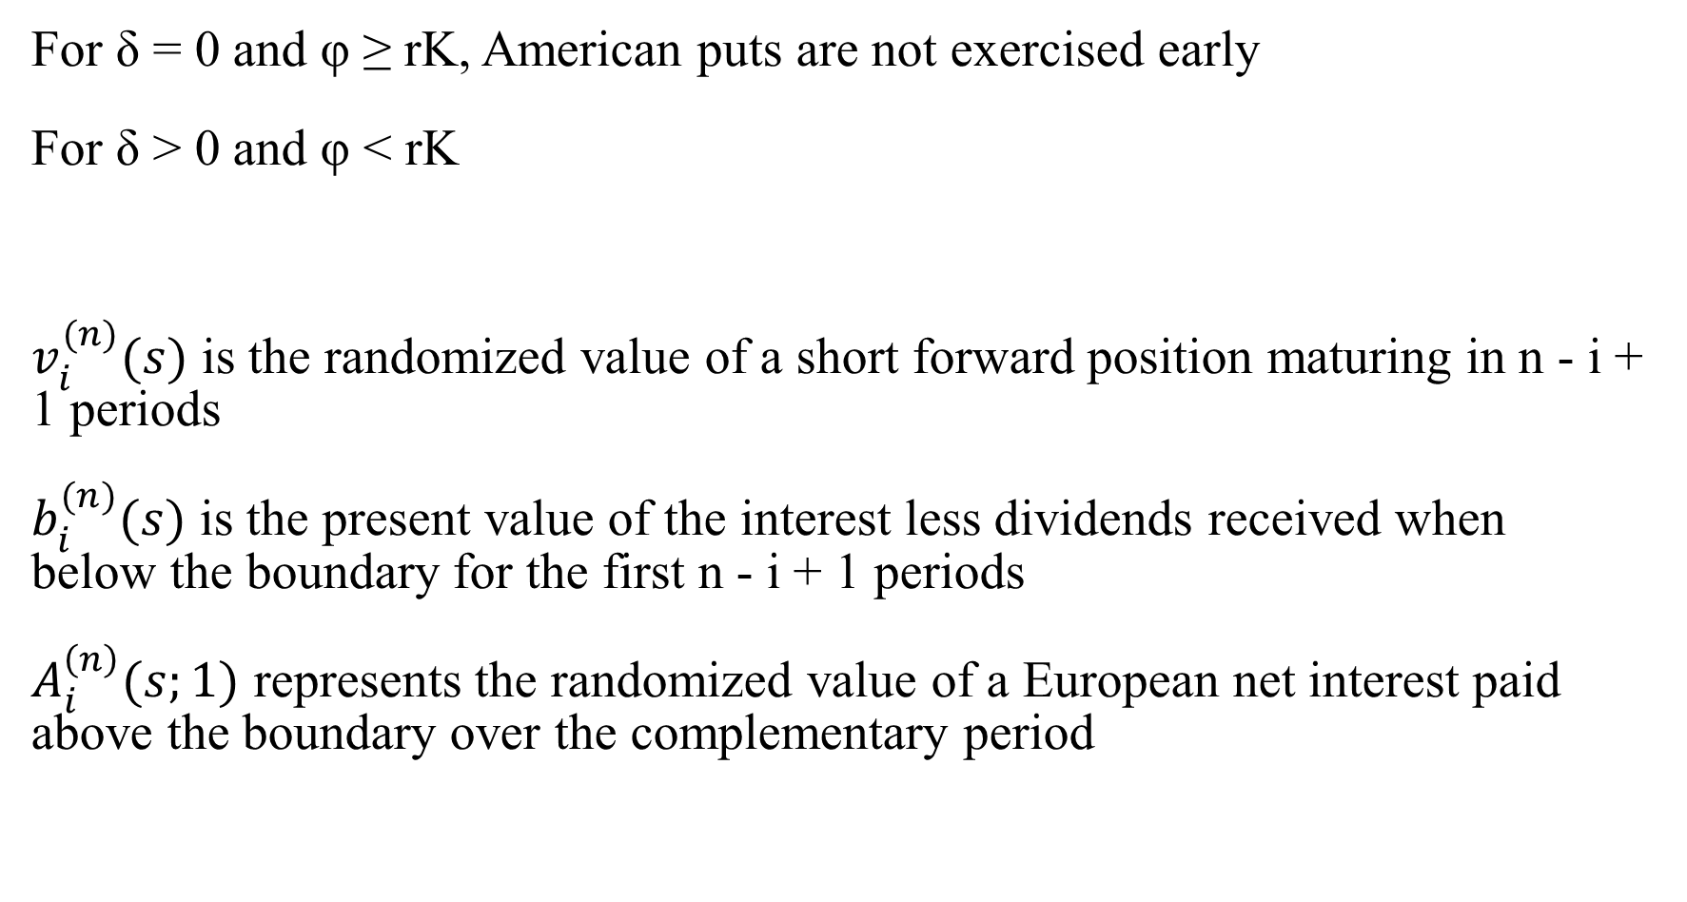
5.1 Dividend and American put
For δ = 0 and φ ≥ rK, American puts are not exercised early
For δ > 0 and φ < rK
$v_{i}^{(n)}(s)$ is the randomized value of a short forward position maturing in n - i + 1 periods
$b_{i}^{(n)}(s)$ is the present value of the interest less dividends received when below the boundary for the first n - i + 1 periods
$A_{i}^{\left(n\right)}(s;1)$ represents the randomized value of a European net interest paid above the boundary over the complementary period

Slide 26

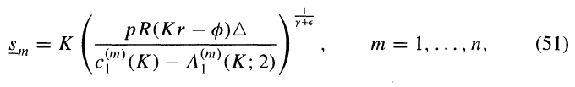
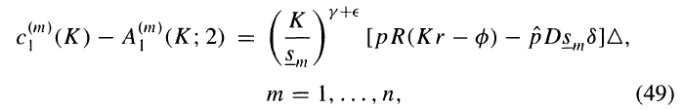

5.1 Dividend and American put
Each critical stock price $S_{m}$ is determined by
if δ = 0 then
if not then solve

Slide 27


5.2 Dividend and American call
McDonald and Schroder (1990) show put call parity for American options while Carr and Chesney (1997) and Schroeder (1997) prove the corresponding result for critical stock prices

Slide 28
6. Summary
The approach is to value options which mature by definition at the nth jump time of a standard Poisson process. Between jump times, the memoryless property of the exponential distribution implies that the option value and exercise boundary are time stationary. As we let the number of jump times approach infinity, keeping the mean maturity fixed, our numerical results indicate that the randomized option value appears to converge smoothly from below to the true American option value. This convergence is dramatically enhanced through the use of Richardson extrapolation.

Slide 29
* Opinion
- Incredibly complex as it touches on different distributions and extrapolation method
- Closed form solution is clear albeit messy looking
- There’s no comparison with other methods.
- More researches needed to test the efficiency of this method

