Slide 1
Manipulation in VIX
Authors:
JOHN M. GRIFFIN and AMIN SHAMS
Presenter:
Amber Yang
10/01/2019
Notes:
Why intersting?

Slide 2
Table of Contents
VIX Overview, and VIX Derivatives Characters
Basic Steps of Manipulation
Volume Patterns at Settlement
Alternative Explanations
Prices, Costs and Mechanics of Manipulation

Slide 3
INSPIRATION
Fair and accurate market prices are fundamental building blocks for efficient capital markets.
Attention in the press on LIBOR, FX, gold, silver, O&G manipulation
market manipulation is quite difficult
  other traders have an economic incentive to trade against the mispricing
  generally revert back as the trader exits his or her position
  expected benefit must be greater than the expected penalty costs
Notes:
Why interesting
Very difficult, CBOE, VIX options and futures are traded in substantial volume
market participants have substantial incentives to manipulate these very same nancial prices on which our economic system relies.
First, if prices move away from fundamentals, other traders have an economic incentive to trade against such deviations. Second, even if a trader successfully moves the price away from the fundamental value, it will generally revert back as the trader exits his or her position. Third, even if a manipulator can impact a security's price and prot from the manipulation, the expected benet must be greater than the expected penalty costs [Becker (1968) and Ehrlich (1973)].
security manipulation should 1 be relatively rare, and this is generally consistent with the evidence in developed markets.

Slide 4
VIX Overview, and VIX Derivatives Characters

Slide 5
WHAT IS VIX
Widely tracked index that gauges the 30-day implied volatility of the market, often referred to as a market ‘fear-gauge’
Provides a measure of market risk and investors' sentiments
Every month, a settlement occurs where the value of monthly VIX derivatives is set equal to the VIX value calculated from SPX options
This settlement value is calculated from a wide range of out-of-the-money (OTM) SPX put and call options with various exercise prices

Slide 6
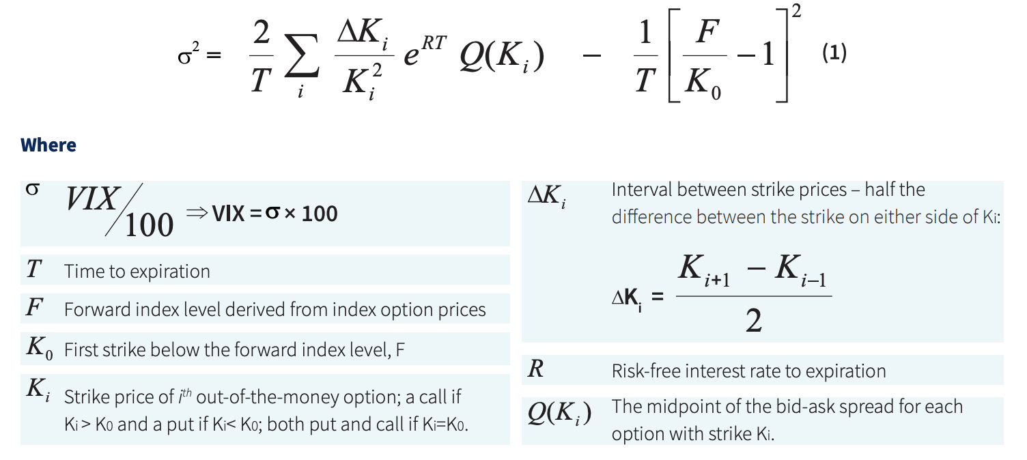
HOW IS VIX CALCULATED
Notes:
The VIX is the square root of the market-implied variance swap rate, calculated based on the exchange-traded options portfolio typically used to hedge an OTC variance swap. It has nothing to do with options volume.
As to the effect of individual contracts (strikes) on the VIX, that depends on how far out of the money they are. The CBOE's calculation uses exclusively OTM options. If the implied volatility of an option near the money changes, it will have a much greater effect than a far OTM option.
All prices of all options are changing constantly in line with changes in the index, but the VIX calculation is quite smat in that it takes away the hustle of resorting to the Black-Scholes model or its assumptions

Slide 7
Basic Steps of Manipulation

Slide 8
HOW IS VIX MUNIPILATED
A manipulator would need to move the prices of these lower-level OTM SPX options at settlement to influence the value of expiring upper-level VIX derivatives.

Slide 9
Steps
1) opening long positions in the VIX derivatives prior to settlement
2) submitting aggressive buy orders in the SPX options during the settlement auction, and thereby causing the auction-clearing prices of SPX options, and as a result, VIX settlement price to rise
3) obtaining the higher price for the upper-level futures or options when they settle.

Slide 10
Characters that make manipulation possible
Upper-level VIX market is large and liquid, while lower-level SPX options, where the VIX values are derived from, are illiquid.
VIX derivatives are cash settled
Settlement occurs within a short period of time based on the SPX options pre-open auction
Notes:
First, when there are multiple markets with dierent price elasticities, manipulation is more feasible than in a single market. Because of dierent market liquidities, it may be feasible for a manipulator to move the price of an illiquid lower-level contract that a larger upper-level contract is tied to.
In fact, the day prior to the settlement, deep OTM options rarely trade. Even trading a small number of contracts can potentially move these options prices. Moreover, the large bid-ask spread of the deep OTM options allows for large price changes inside the spread that are therefore immune to arbitrage.
manipulation is difficult for an asset with physical settlement. Suppose a manipulator pushes the price of a lower-level asset up. Nonetheless, when physical delivery of the asset takes place, the manipulator will take possession of an asset at an inated price, and that asset may quickly fall to the original value when the manipulator tries to exit the position. With cash settlement, a manipulator can deploy more capital in the upper-level asset than the position size that he will take in the lower-level asset.
Third, a nite time period to manipulate prices can make the costs of manipulation smaller.

Slide 11
Volume Patterns at Settlement

Slide 12
Patterns Overview
  Patterns:
  Significant trading volume spikes at exact time the monthly VIX settle
  Spike occurs only in OTM SPX options
  No such spike in volume for similar index options (OEX, SPY) that are unconnected to volatility index derivatives.

Slide 13
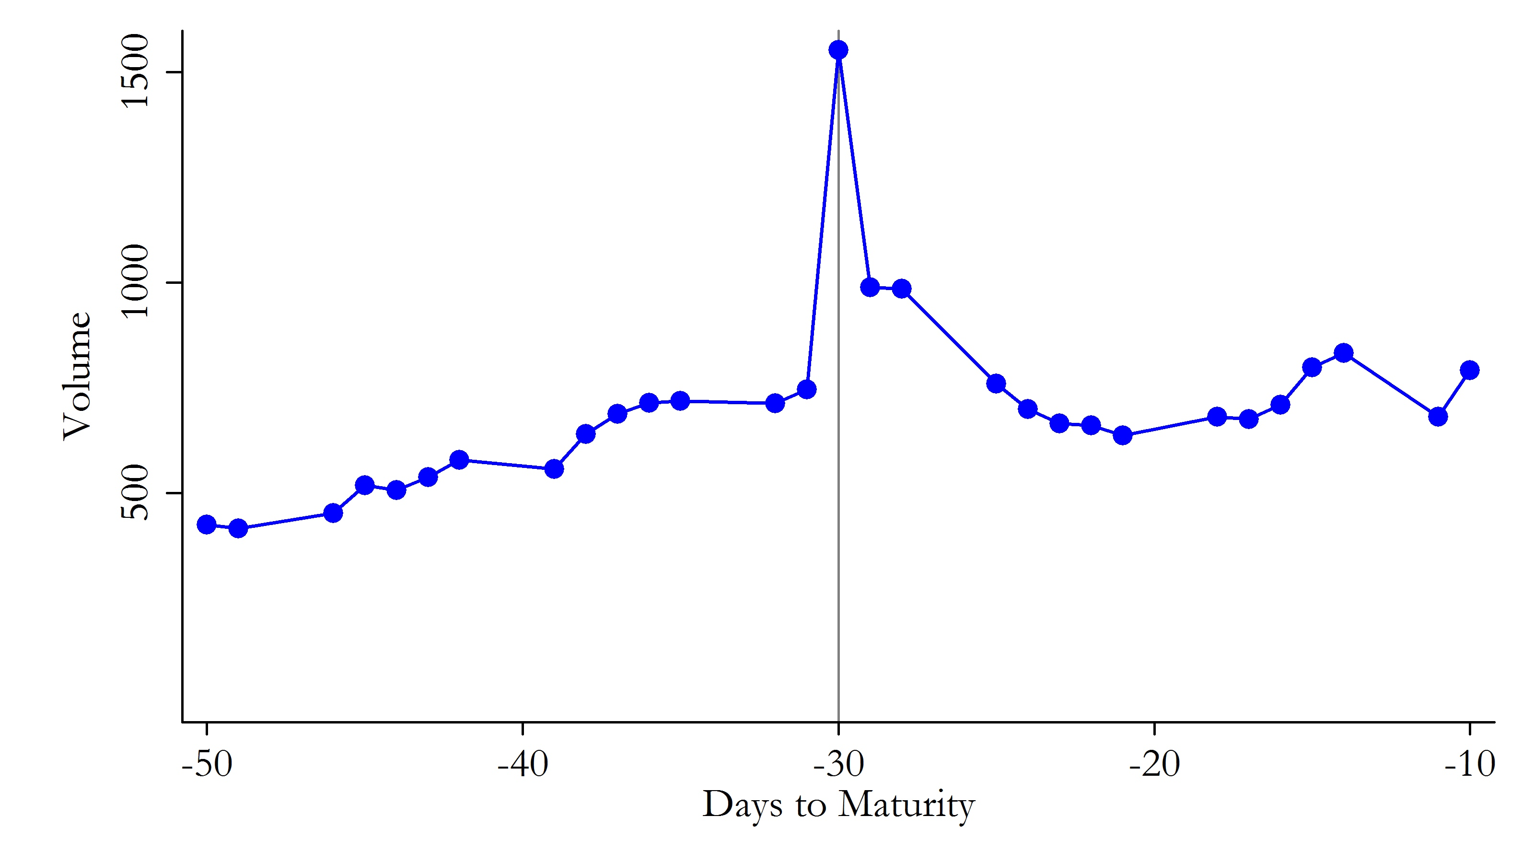
Panel A: S&P 500 Options Daily Trade Volume
Notes:
This figure shows the average trade volume of monthly S&P 500, S&P 100, and SPY options by days to maturity. The sample consists of the option chains used in VIX settlement calculations from January 2008 to August 2014. Panel A shows the daily trade volume of S&P 500 options averaged across dierent strike prices and settlement dates. The center vertical line shows 30 days to maturity, which is the settlement day for VIX derivatives.

Slide 14
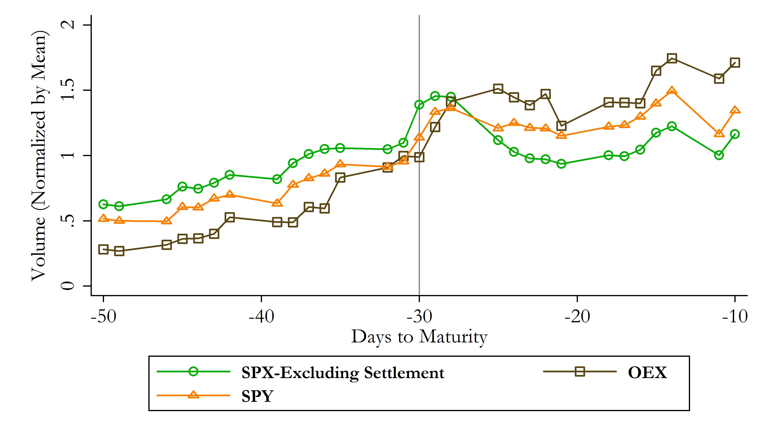
Panel B: Options Daily Trade Volume (Normalized by Mean)
Notes:
Panel B shows the average daily trade volume calculated in the same way as Panel A for S&P 500 options excluding the trades occurring at the preopening settlement (green circles), S&P 100 options (brown squares), and SPY options (orange triangles). The volume in Panel B is normalized by the average trade volume for each option during the period. Panel C shows the SPX options' trade volume separately for OTM (blue circles) and ITM (gray squares) options.

Slide 15
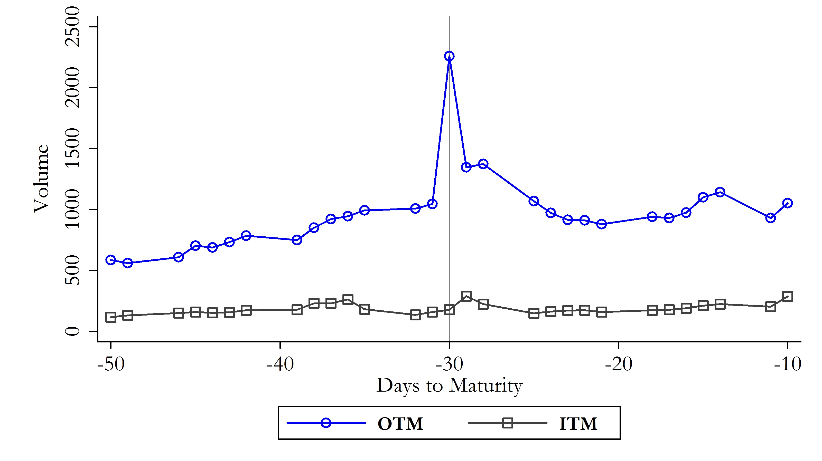
Panel C: OTM and ITM Options Daily Trade Volume

Slide 16
Trading Pattern of EURO STOXX 50 Put Options during the VSTOXX Settlement
The mechanism:
  European volatility index, the VSTOXX, which is similar in nature to the VIX but has a different settlement procedure with only options at Euro 0.5 and above being included in the calculation.
  Additionally, the VSTOXX index is calculated every five seconds, and the settle-ment is calculated as the average of the index values between 11:30 a.m. and 12:00 p.m.
Notes:
This design puts a very high weight on the option with e0.5, because small changes in price can exclude or include the option from settlement calculation. Interestingly, the trade volume per minute for options at e0.5 increases to around 130 times of that in the rest of the day, whereas the options below this threshold experience minimal trading activity.

Slide 17
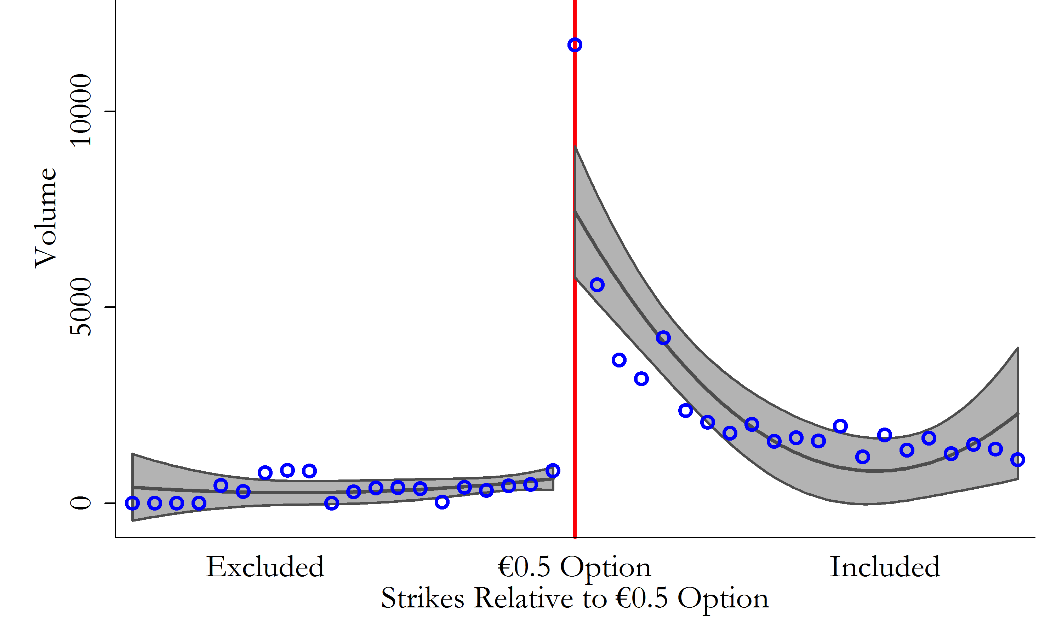
Panel A: Trade Volume around the 0.5 Cutoff
Notes:
Panel A shows the volume across strikes of EURO STOXX 50 put options around the e0.5 cutoff.
The blue circles show the average volume for strikes sorted relative to the e0.5 option across settlements.
The gray areas represent the 95% confidence interval for the fitted values of the volume as a quadratic function of the ranks relative to the cutoff.

Slide 18
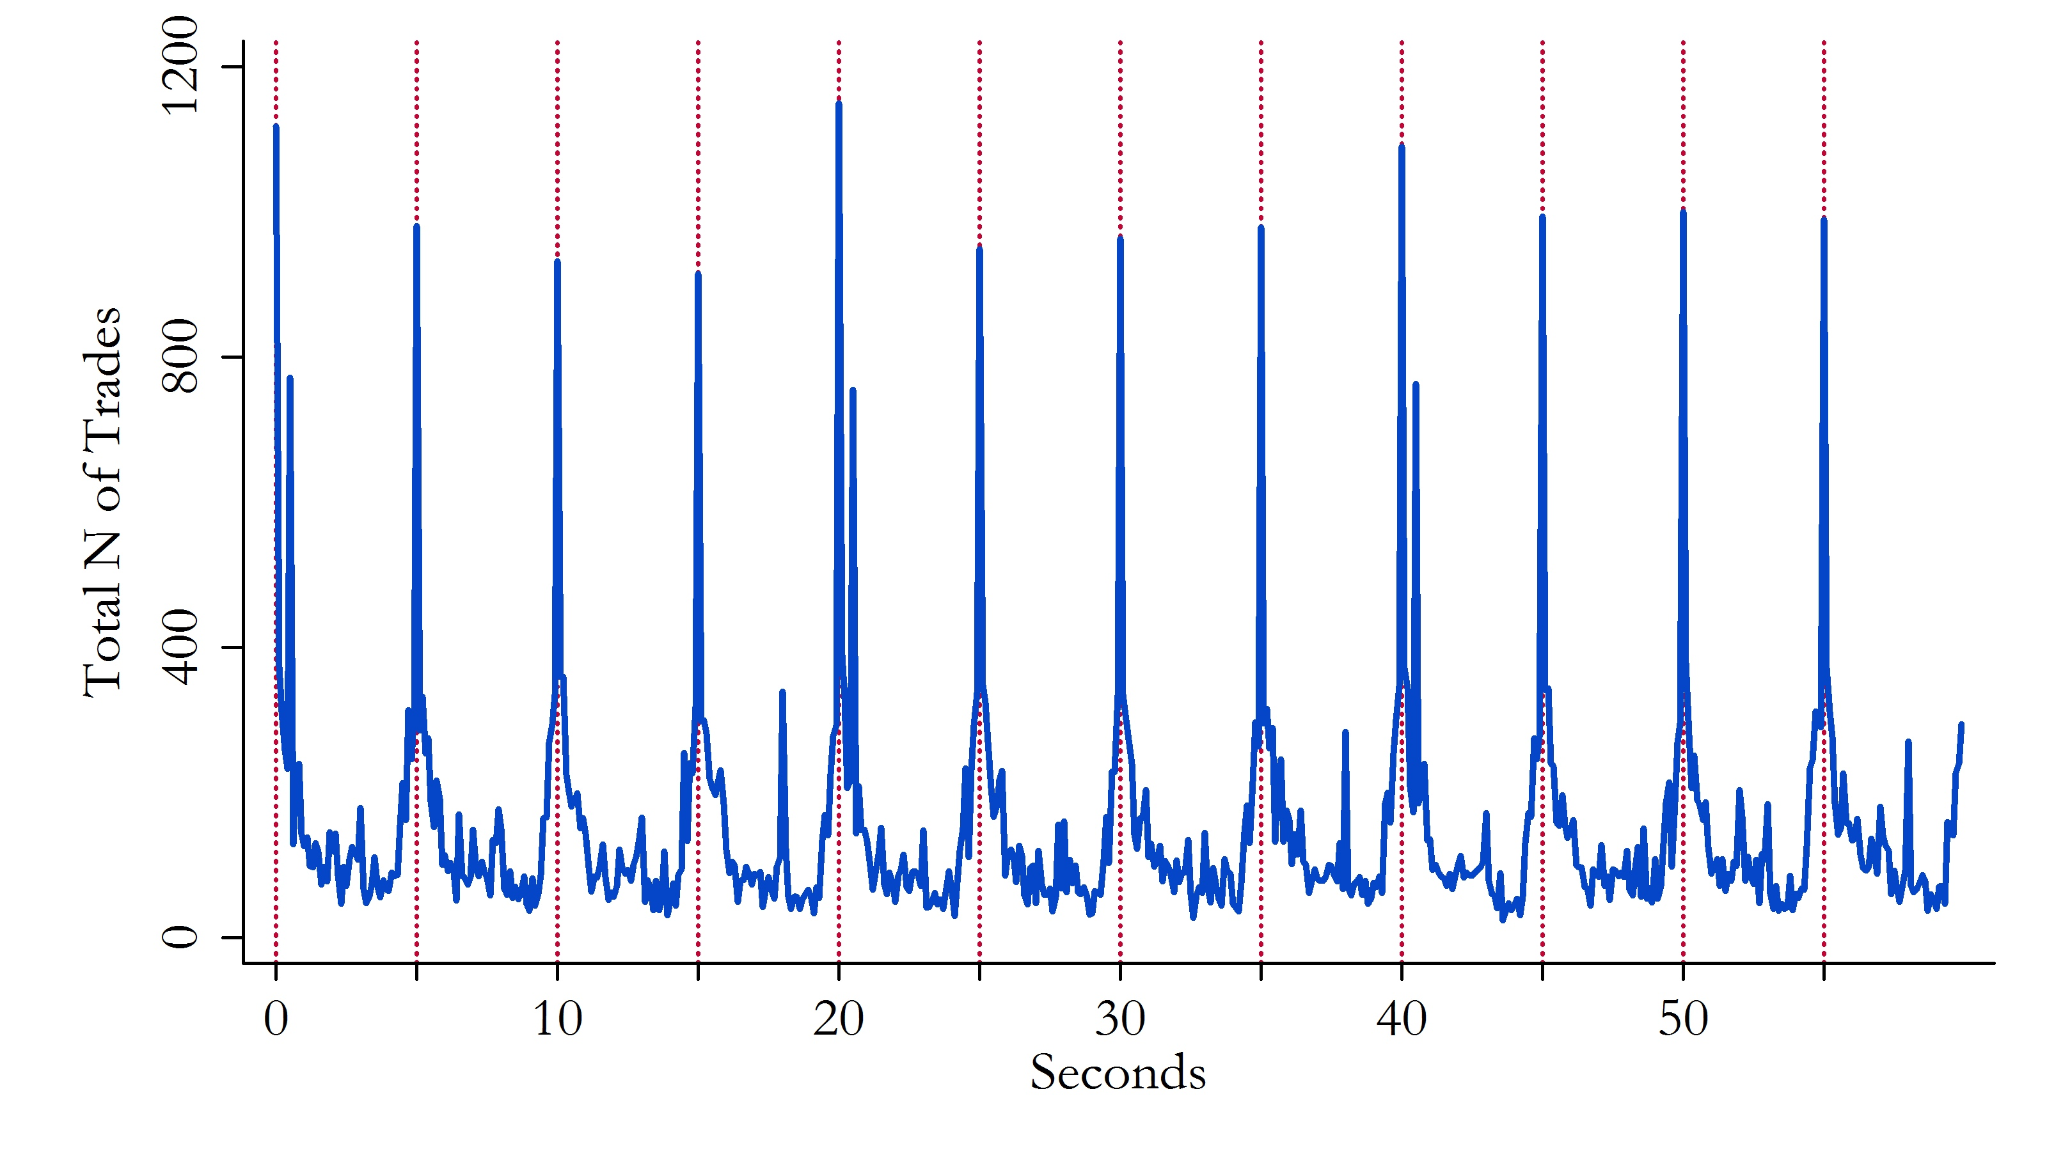
Panel B: Number of Trades over Time
Notes:
Panel B shows the time clustering of trades during the settlement.
To optimally influence the price, trade every 5 seconds.

Slide 19
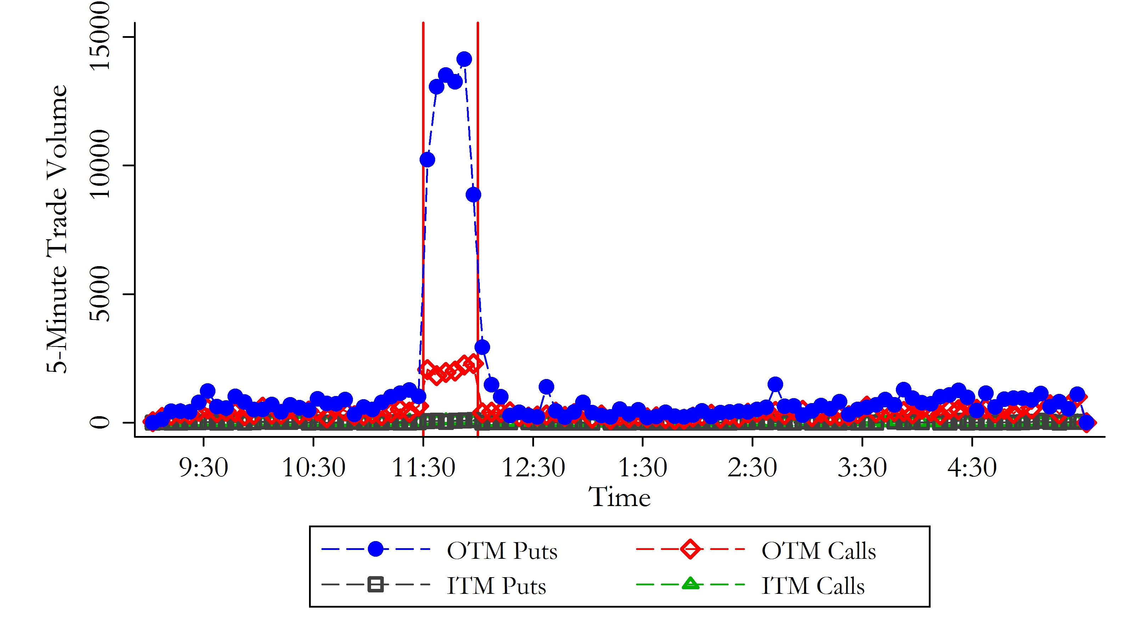
Panel C: Trade Volume

Slide 20
OLS: Trade Volume of SPX Options on Settlement Days
- SettlementDay is a dummy variable that takes the value of one if the day is a VIX settlement day, and zero otherwise
- OTM is a dummy variable equal to one if option i at settlement time t is out-of-the-money and equal to zero if in-the-money
- α t is the SPX options expiration date fixed effect
Notes:
we use the expiration date xed eect when possible to control for variations in volume and other characteristics of options across dierent expiration dates and focus on the cross-section of dierent strike prices within expiration dates

Slide 21
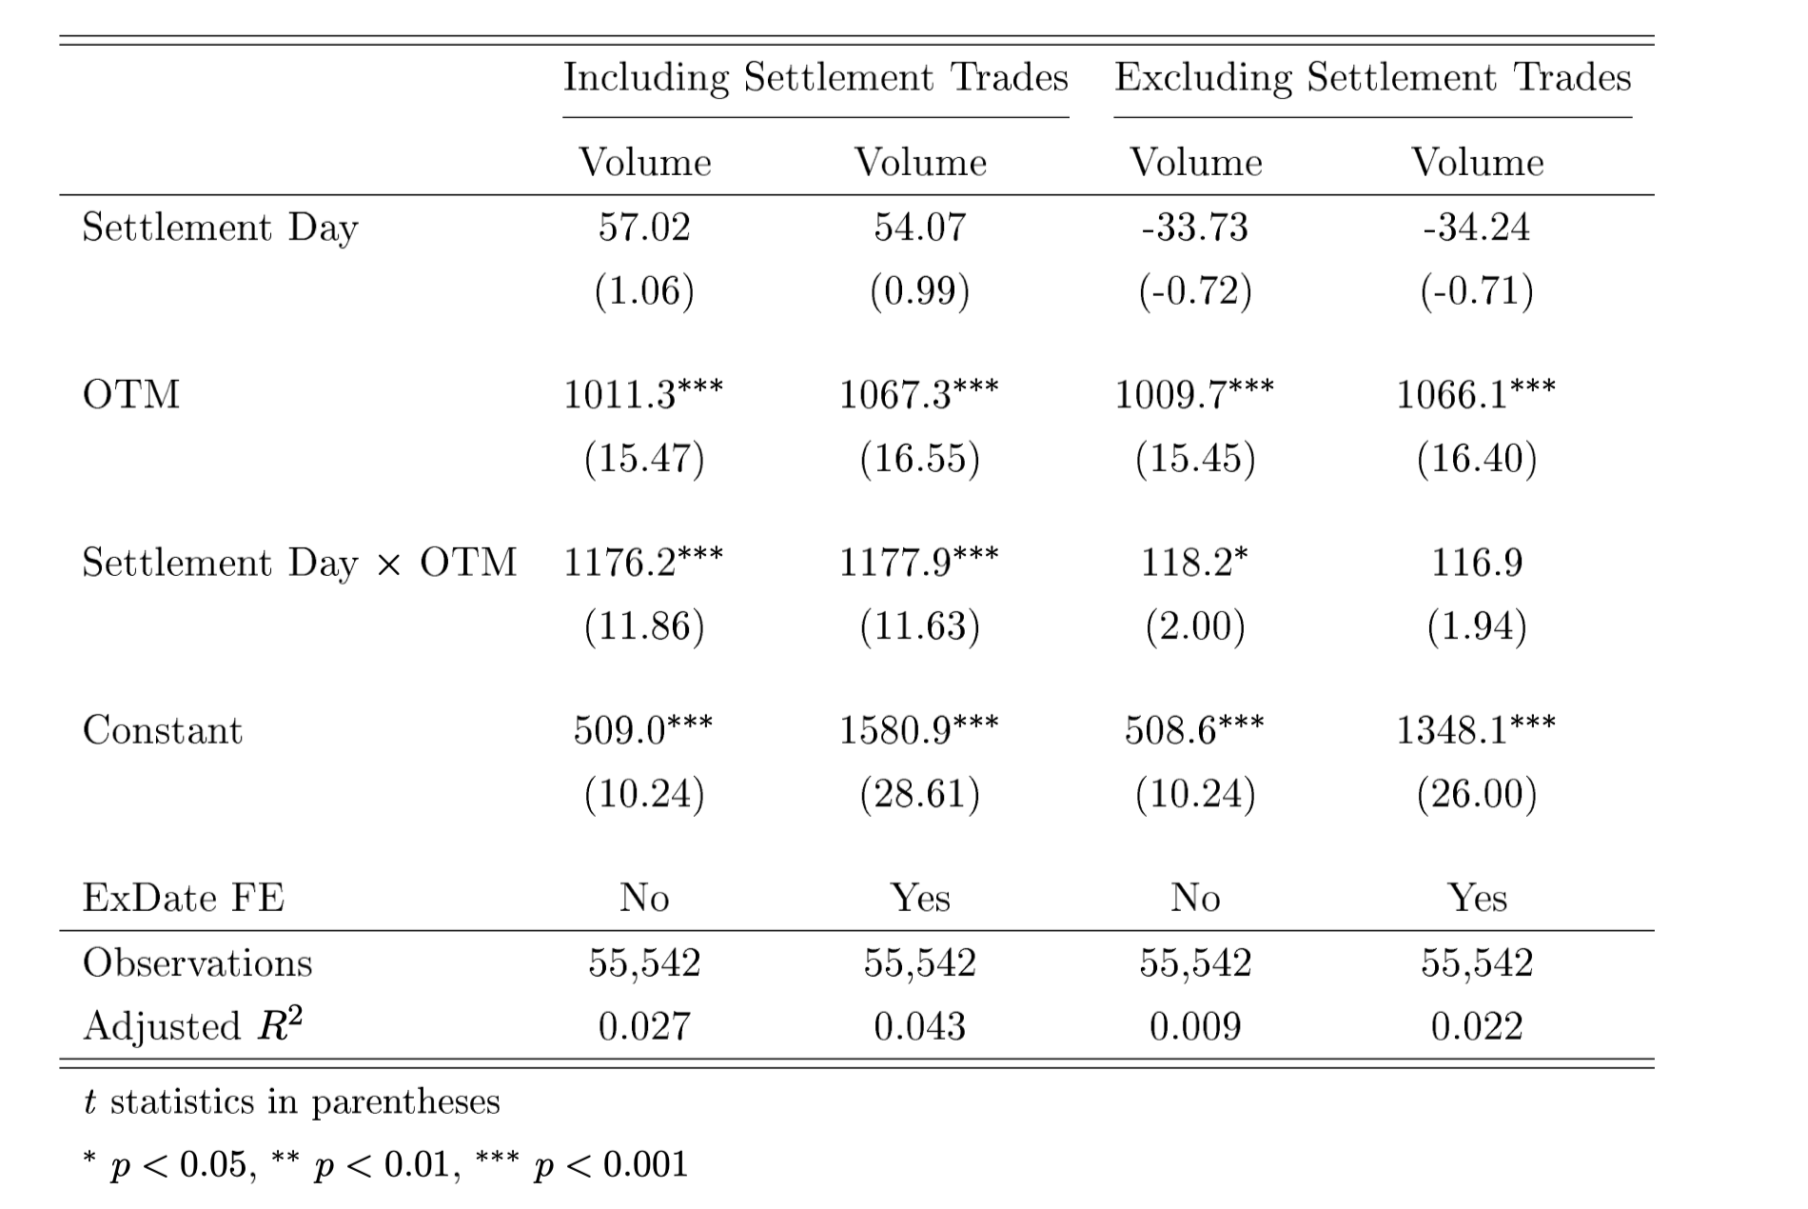
Results
the increase in volume on the settlement day is entirely in OTM options (Settlement Day times OTM) and not in ITM options, which is the benchmark;
the increase is economically very large;
c) it is statistically significant with a statistic of 11.86. These results are consistent with SPX trading being driven by the VIX settlement.
Notes:
The Table shows that
the increase in volume on the settlement day is entirely in OTM options (Settlement Day times OTM) and not in ITM options, which is the benchmark;
the increase is economically very large;
and c) it is statistically significant with a -statistic of 11.86. These results are consistent with SPX trading being driven by the VIX settlement.

Slide 22
Alternative Explanations

Slide 23
pent-up liquidity demand
Deep OTM options are normally very illiquid and costly to trade because of high bid-ask spreads.
We posit that the VIX settlement auction, in conjunction with a belief that other traders participate in the auction, provides an opportunity for those who have pent-up demand to trade deep OTM options.
Thus, the patterns of increasing volume for deep OTM options may just be a result of the settlement being used as a coordination device. We provide multiple tests here that help disentangle the liquidity and manipulation explanations.
Notes:
The increase in trading volume of normally illiquid deep OTM put options could be driven by pent-up demand for these options, where higher liquidity is possibly created by the special settlement as a coordination device. However, OTM call options are also included in the special settlement procedure, but empirical tests show that OTM calls see lower, not higher volume at settlement as they become more OTM. This is inconsistent with the pent-up liquidity hypothesis but consistent with traders strategically following the VIX settlement formula which gives deeper OTM calls less weight.

Slide 24
Issues with Alternative Explanations
First, if the settlement auction is a period of coordinated liquidity for all options, the liquidity hypothesis predicts higher volume for deep OTM options. This includes the illiquid deep OTM call options as well as deep OTM puts.
Comparison with EURO STOXX.
Notes:
the volume is particularly high for options near the e0.5 cuto because those options are very critical to the settlement calculations;
In the U.S. VIX settlements there is no such cuto. On average, if one compared to the U.S. VIX calculation, 38 put options of less than e0.5 ($0.67 on average over the sample period) have large volume and are included in each U.S. VIX settlement,
Those options account for 52% of the aggregate settlement volume for put options over the entire sample period.

Slide 25
Prices, Costs and Mechanics of Manipulation

Slide 26
Prices, Costs and Mechanics of Manipulation
When comparing the VIX value at settlement to a VIX value computed from the mid-quotes of the SPX options right after the settlement, where both are calculated from the same range of options included in both the settlement and the open, the two diverge by an average of 31 basis points, or 1.5% of the VIX settlement value. The distortionary costs of settlement deviations to exchange-traded VIX derivatives are approximately $1.81 billion.
prices appear to be moved by aggressive incremental orders in the pre-open period prior to settlement

Slide 27
Thoughts
Price deviations at settlement of other CBOE volatility indices with similar processes and commonly find deviations of more than five percent for these small indices, highlighting the robustness and generalizability of the findings
Further steps could be on regulations of the manipulation activities

