Slide 1
Metallgesellschaft: A Prudent Hedger Ruined, or a Wildcatter on NYMEX
Stephen Craig Pirrong
Presented by Shuang Tang

Slide 2
MG’s Energy Market Activities
Product: 5- and 10-year fixed-price contracts on heating oil and gasoline
firm fixed contract: specifies delivery schedule
firm flexible contract: defer or accelerate purchases
both can be terminated at will
To protect against increases in energy prices: purchased near-month crude oil and gasoline futures, barrel-to-barrel strategy
Stack and roll hedging
Risks:
Basis risk: maturity mismatch, asset mismatch
Liquidity risk: immediate loss, margin call
Operational risk: loss in faith
Backwardation---Contango
As a result of adverse movements in oil prices, the firm suffered real mark-to-market losses of as much as one billion dollars.
long | short
near-month futures contracts | long-term forward contracts
near-month futures contracts
near-month futures contracts
near-month futures contracts

Slide 3
Backwardation & Contango
Contango:
future/forward price of underlying asset higher than current spot price
Backwardation:
future/forward price of underlying asset lower than current spot price

Slide 4
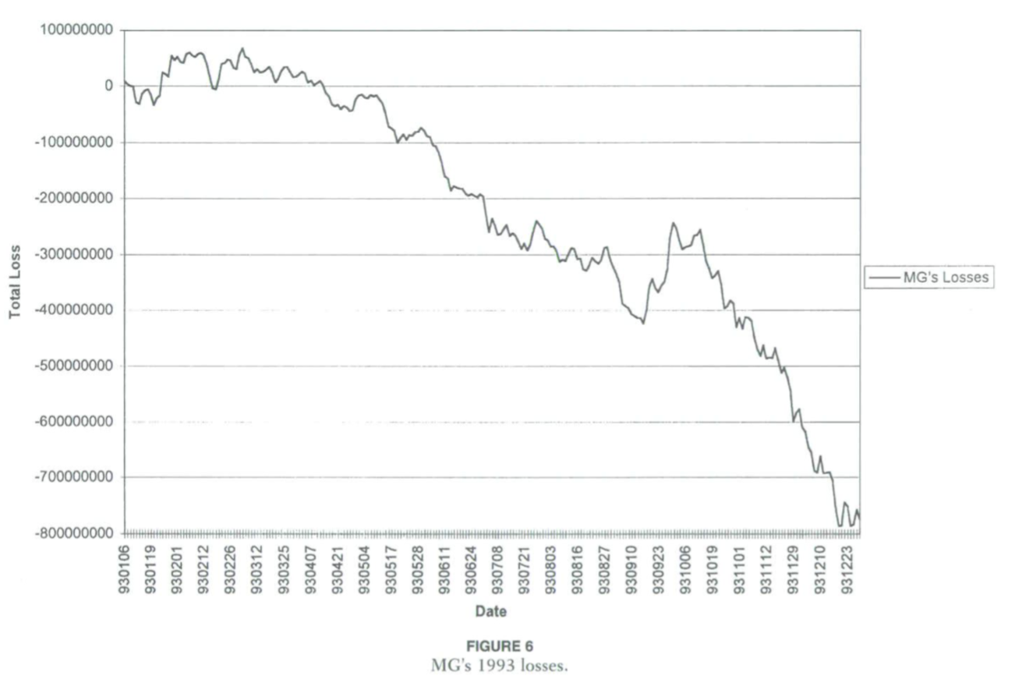
MG’s 1993 Losses

Slide 5
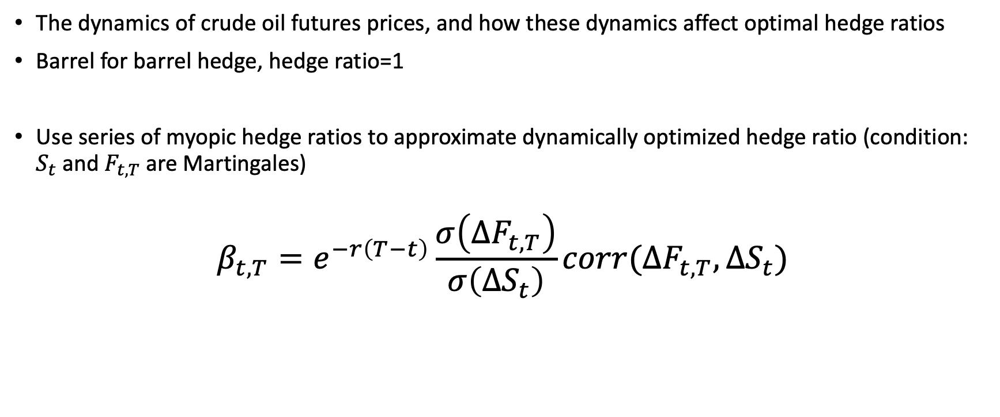
New Thoughts in the Essay
The dynamics of crude oil futures prices, and how these dynamics affect optimal hedge ratios
Barrel for barrel hedge, hedge ratio=1
Use series of myopic hedge ratios to approximate dynamically optimized hedge ratio (condition: $S_{t}$ and $F_{t, T}$ are Martingales)
$$β_{t,T}=e^{−r\left(T−t\right)}\frac{σ\left(∆F_{t,T}\right)}{σ\left(∆S_{t}\right)}corr(∆F_{t,T},∆S_{t})$$

Slide 6
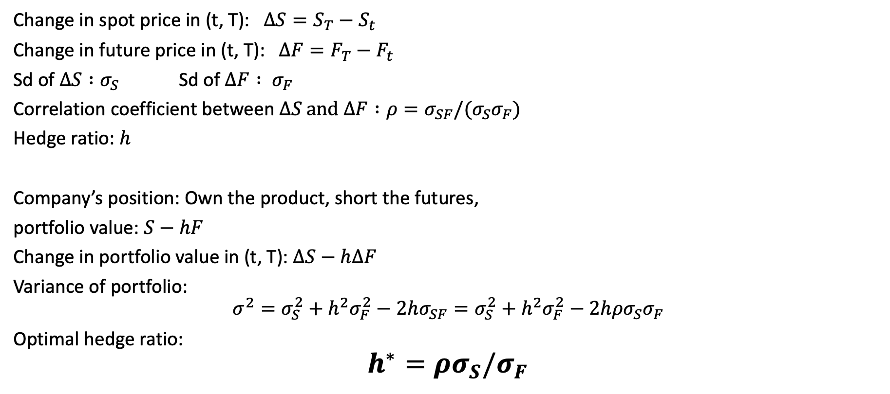
Hedge Ratio
Change in spot price in (t, T): $∆S=S_{T}−S_{t}$
Change in future price in (t, T): $∆F=F_{T}−F_{t}$
Sd of $∆S :σ_{S}$ Sd of $∆F : σ_{F}$
Correlation coefficient between $∆S \text{and} ∆F :{ρ=σ}_{SF}/(σ_{S}σ_{F})$
Hedge ratio: $h$
Company’s position: Own the product, short the futures,
portfolio value: $S−hF$
Change in portfolio value in (t, T): $∆S−h∆F$
Variance of portfolio:
$$σ^{2}=σ_{S}^{2}+{h^{2}σ}_{F}^{2}−2hσ_{SF}=σ_{S}^{2}+{h^{2}σ}_{F}^{2}−2hρσ_{S}σ_{F}$$
Optimal hedge ratio:
$$h^{∗}=ρσ_{S}/σ_{F}$$

Slide 7
Dynamics of Energy Prices
Correlations and variances may change over time because of:
---Stationarity: stationarity in oil prices causes the volatility of the deferred to rise as time passes
---Spread between spot and deferred prices: the theory of storage implies that the variances and correlations should depend upon the spread between spot and deferred prices (net of interest and storage costs)
---Shocks to the oil market: due to OPEC policy changes, for example can cause changes in the relevant variances and correlations, and, thus, in hedge ratios.

Slide 8
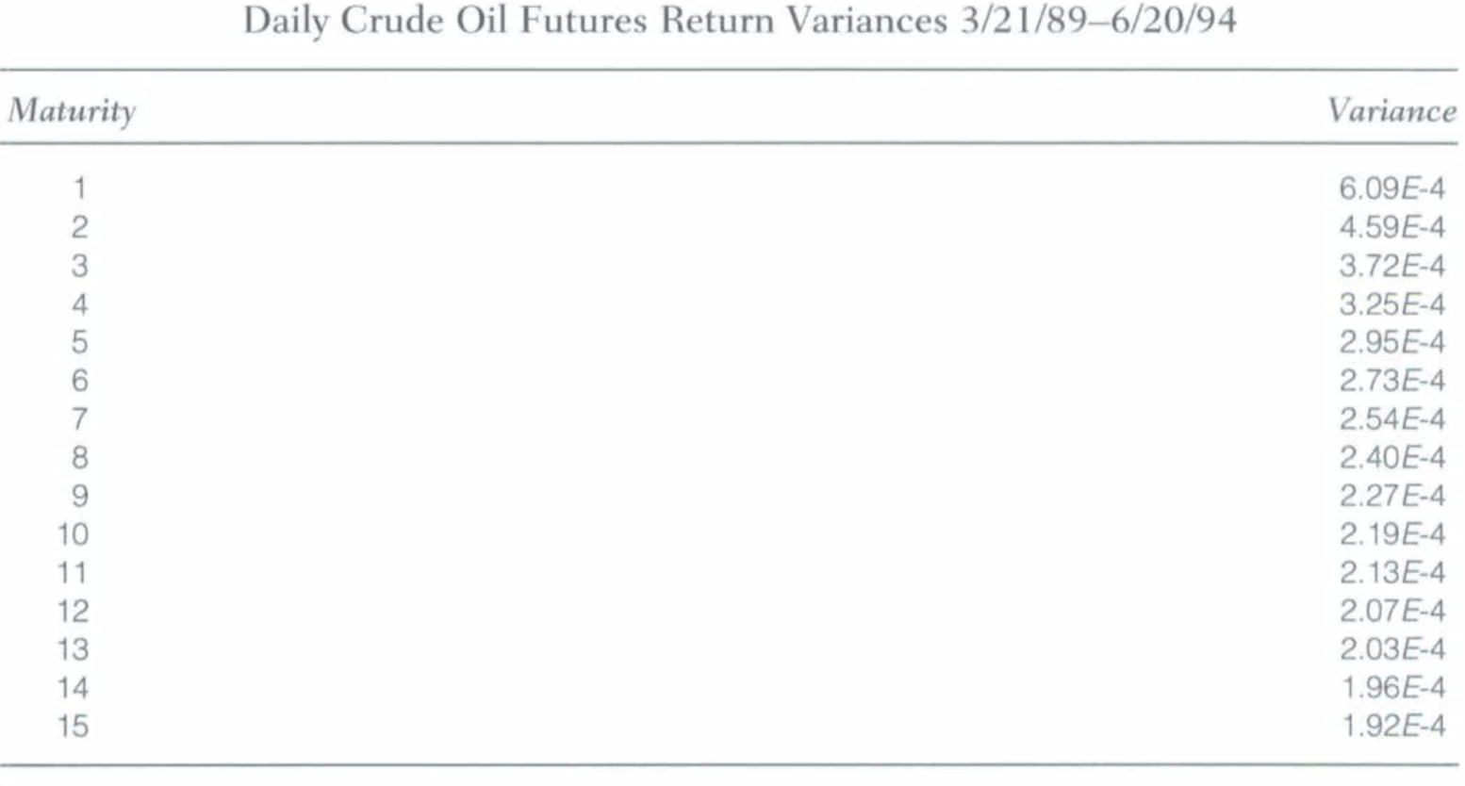
Exploratory Data Analysis
Future return variances with maturity:
Variances decrease monotonically with time to expiration, consis- tent with oil price stationarity.

Slide 9
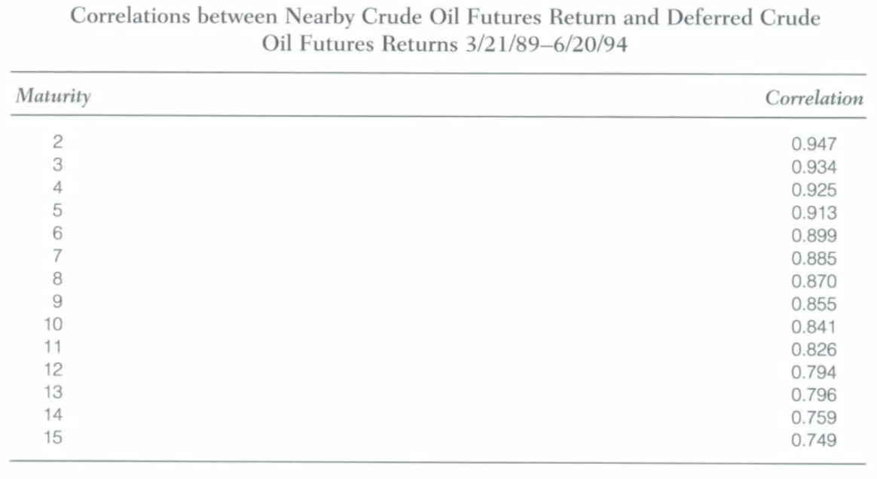
Exploratory Data Analysis
Correlations between the 1 month oil futures return and returns on contracts with maturities greater than I month
Correlations are monotonically decreasing with expiration, and are far below 1 for maturities of 10 months or more

Slide 10
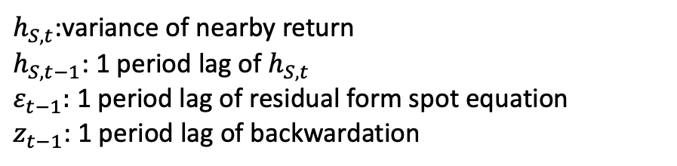
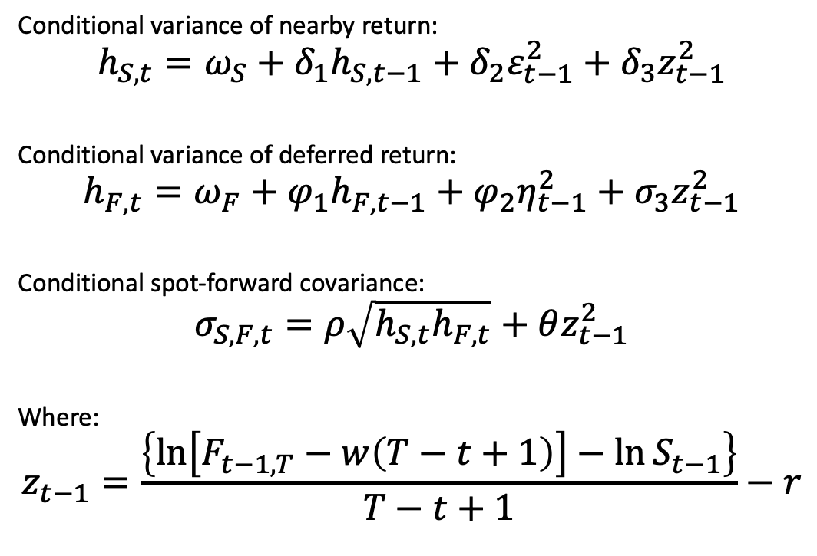
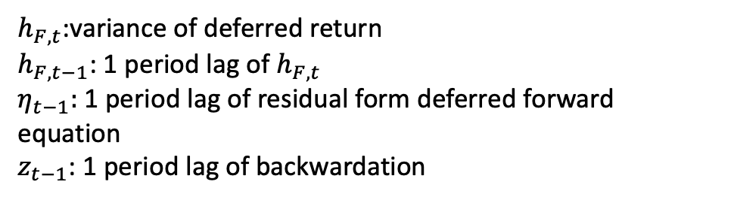
Model: Backwardation Adjusted GARCH
Conditional variance of nearby return:
$$h_{S,t}=ω_{S}+δ_{1}h_{S,t−1}+δ_{2}ε_{t−1}^{2}+δ_{3}z_{t−1}^{2}$$
Conditional variance of deferred return:
$$h_{F,t}=ω_{F}+φ_{1}h_{F,t−1}+φ_{2}η_{t−1}^{2}+σ_{3}z_{t−1}^{2}$$
Conditional spot-forward covariance:
$$σ_{S,F,t}=ρ\sqrt{h_{S,t}h_{F,t}}+θz_{t−1}^{2}$$
Where:
$$z_{t−1}=\frac{\left\{\ln\left[F_{t−1,T}−w\left(T−t+1\right)\right]−\ln{S_{t−1}}\right\}}{T−t+1}−r$$
$h_{S,t}$:variance of nearby return
$h_{S,t−1}$: 1 period lag of $h_{S,t}$
$ε_{t−1}\text{: }\text{1 }\text{period} \text{lag} \text{of}$ residual form spot equation
$z_{t−1}$: $\text{1 }\text{period} \text{lag} \text{of}$ backwardation
$h_{F,t}$:variance of deferred return
$h_{F,t−1}$: 1 period lag of $h_{F,t}$
$η_{t−1}\text{: }\text{1 }\text{period} \text{lag} \text{of}$ residual form deferred forward equation
$z_{t−1}$: $\text{1 }\text{period} \text{lag} \text{of}$ backwardation
percentage difference between the actual futures price and the full-carry price calculated from the spot price, the cost of storage, w, and the interest rate.

Slide 11

Model: Backwardation Adjusted GARCH
BAG hedge ratio:
$$β_{t,T}=e^{−r(T−t)}\frac{F_{t,T}}{S_{t}}\frac{σ_{S,F,t}}{h_{S,t}}$$
OG hedge ratio:
$$β_{t,T}=e^{−r\left(T−t\right)}\frac{σ\left(∆F_{t,T}\right)}{σ\left(∆S_{t}\right)}corr(∆F_{t,T},∆S_{t})$$

Slide 12
Application of BAG hedge ratio
reestimating the model on a weekly basis.
use estimated parameters of 3/21/89—8/31/92 period for 7-day period hedge ratio commencing 9/1/92.
use estimated parameters of 3/21/89—9/7/92 period for 7-day period hedge ratio commencing 9/8/92, and so on.
Ensure hedge ratio estimates are based on information available to MG when it was making its decisions.
Using these parameters, the fitted value of the spot return variance and the spot-deferred return covariances are calculated to determine variance-minimizing hedge ratios.

Slide 13
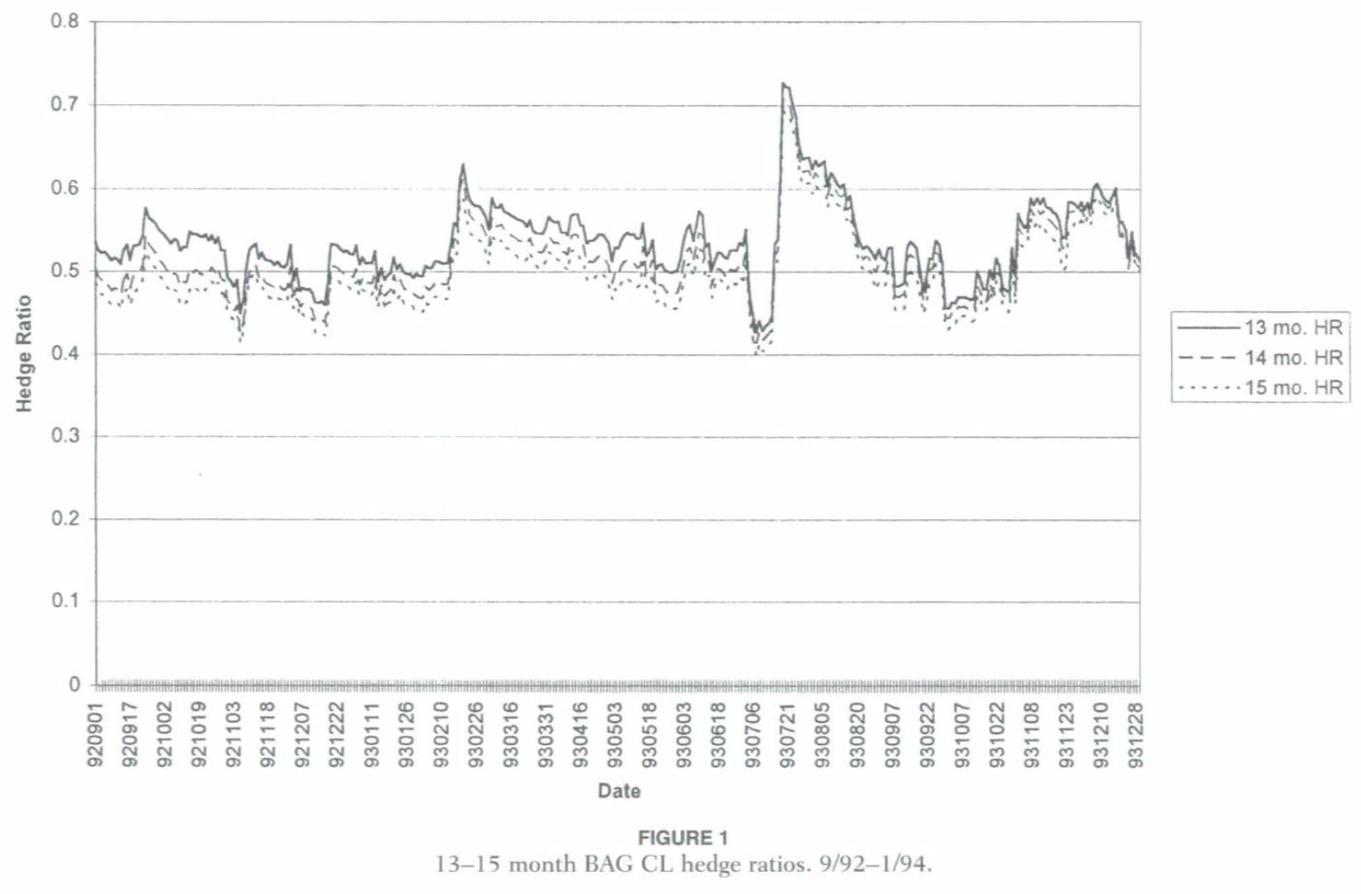
Dynamic BAG Hedge Ratio
09/1992—06/1993:
BAG hedge ratios ~0.5
06/1993—12/1993:
BAG hedge ratios
~(0.5, 0.6)
Barrel-for-barrel hedge was strongly overhedged
these results provide strong evidence that the barrel-for-barrel strategy did not substantially reduce MG's risk.

Slide 14
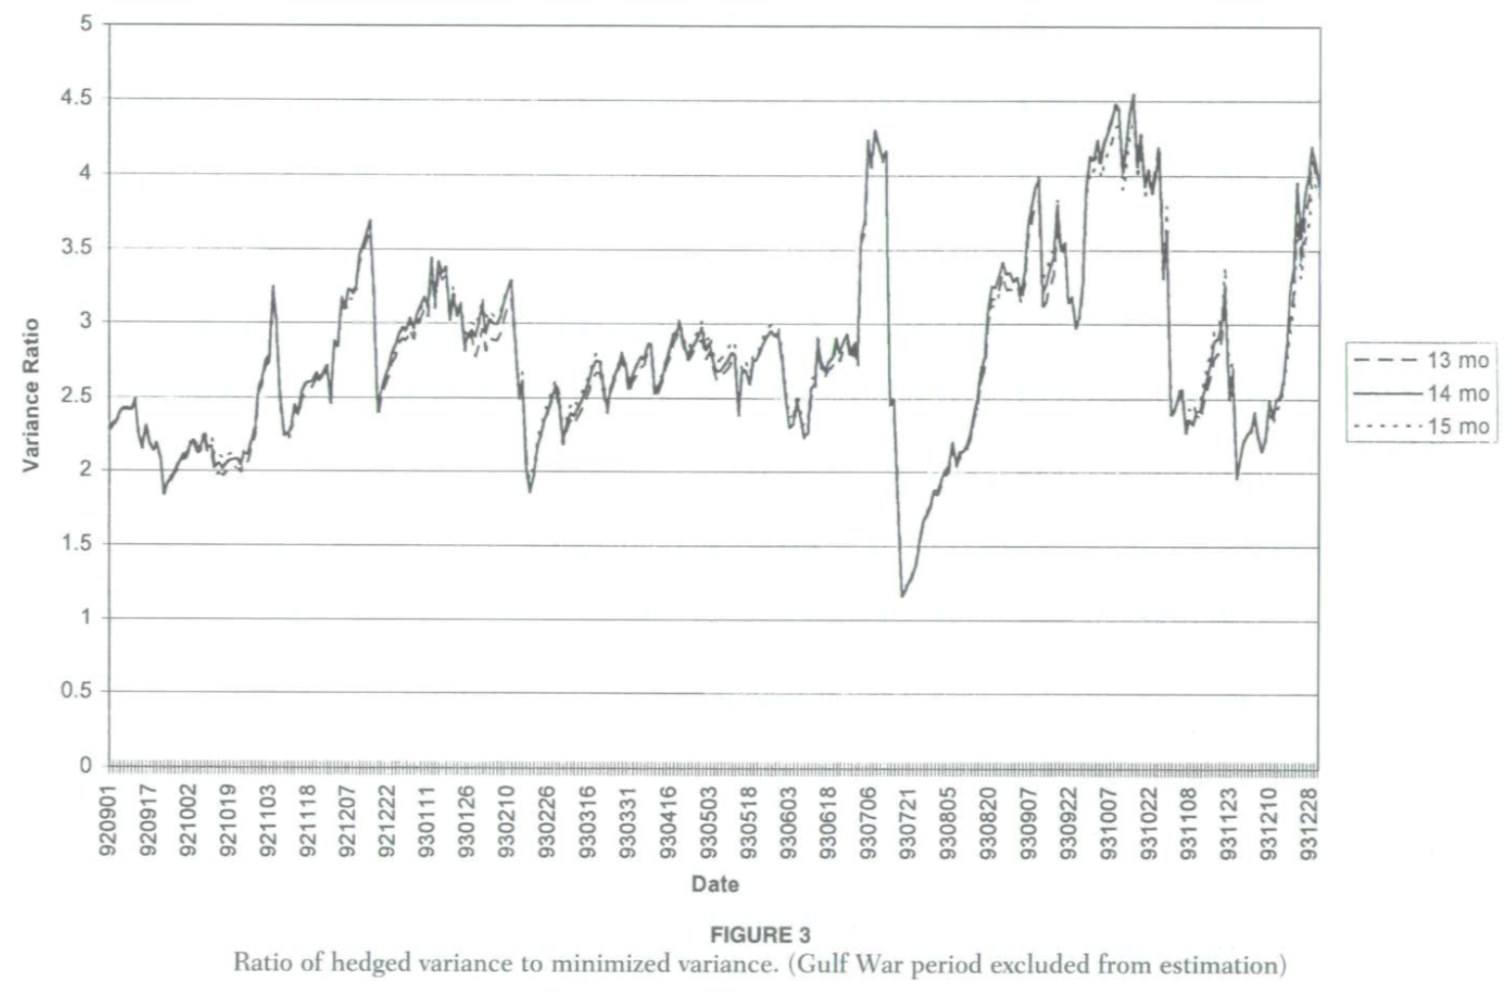
Comparison between Barrel-to-barrel and BAG Method
the ratio between the variance of the barrel-for-barrel hedge and that of the vari- ance-minimizing hedge for the 13—15-month maturities.
Ratio range: 1.19 - 4.50
MG bore 19 - 350% more risk than was necessary

Slide 15
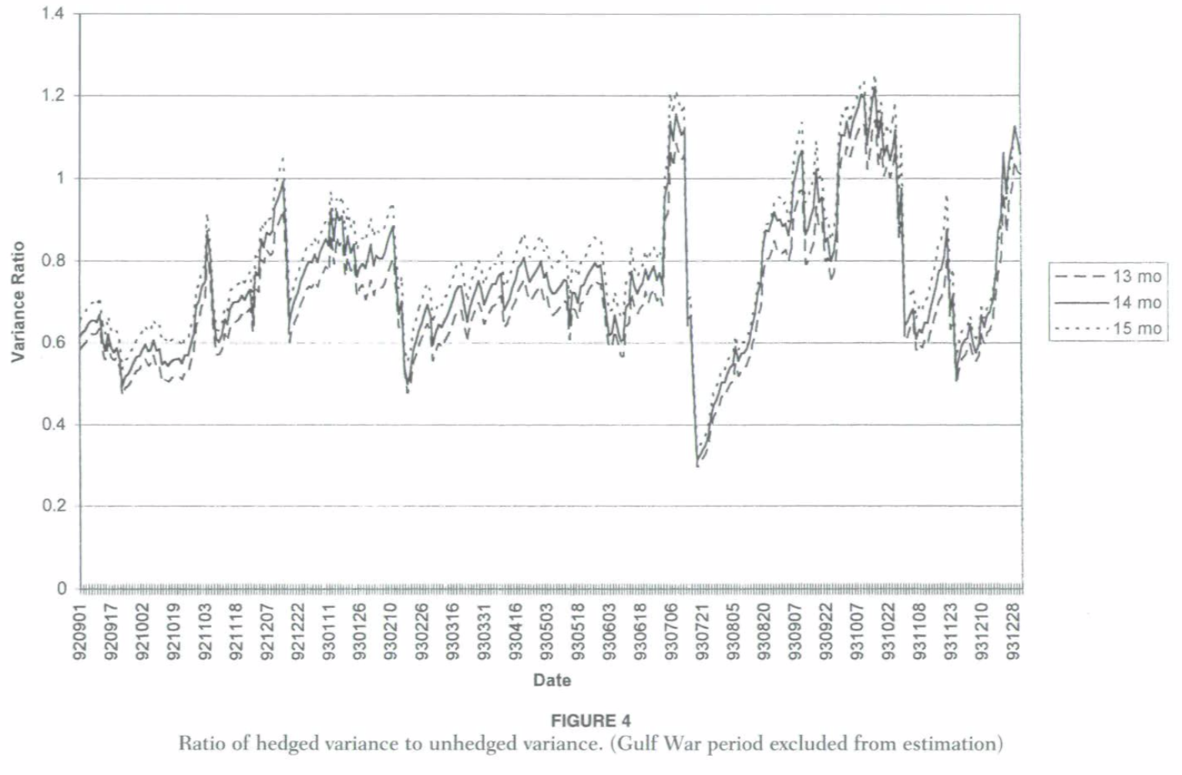
Comparison between Barrel-to-barrel and Unhedged Method
at times it was larger than the variance of the unhedged forward contracts.
Variance minimizing ratio far less than 1

Slide 16
Conclusion from BAG model
Barrel-to-barrel strategy---Overhedging Problem:
---Bear more risk(larger vol):
The barrel-for-barrel strategy was at least 2—4 times riskier than the variance-minimized position
---Result in substantial kurtosis(fat tail) :
GARCH model shows crude oil returns follow a t distribution with 5 degree of freedom; the excessive spot crude oil futures position impose substantially more kurtosis on the firm.
---Vulnerable to steepening of crude oil term structure: only hedge 1 side of th trade
---Liquidity problem:
Its futures contracts were marked to market daily. As a result, the firm needed cash to finance margin calls as the nearby futures price fell in late 1993. It was the inability to finance these margin flows that forced the firm to seek assistance from its bankers.

Slide 17
Add Embedded Option Features
the firm-fixed supply contracts permited the buyers to terminate their contracts and, upon termination, receive one-half of the difference between the prevailing spot price (measured by the nearby futures price) and the fixed price established in the contract times the volume remaining under the contract.
If the barrel-for-barrel position increases variance in the absence of the embedded option, it increases the variance if the contract includes the option as well. The option feature mitigates the overhedging somewhat, but not enough to turn the barrel-for-barrel strategy into a true hedge.
Conclusion: the options embedded explicitly in MG’s firm-fixed contracts cannot reverse, and may worsen the problem.

Slide 18
Conclusion: MG Overhedged
First, the stationarity of oil prices implies that volatilities decline systematically with time to expiration.
Second, the correlation between spot and deferred prices is imperfect, and this correlation also declines systematically as time to expiration of the deferred increases. A variance-minimizing hedger should reduce hedge ratios far below 1 in response to these factors.

Slide 19
Highlight of the Paper
Try to tackle the classic problem in a perspective people rarely look into before: hedge ratio rather than just liquidity
Updated the hedge ratio to a dynamic process, which is in line with the everchanging oil price market
Developed GARCH model to take into account how backwardation affects variance-minimizing hedge ratios

